Slide 1
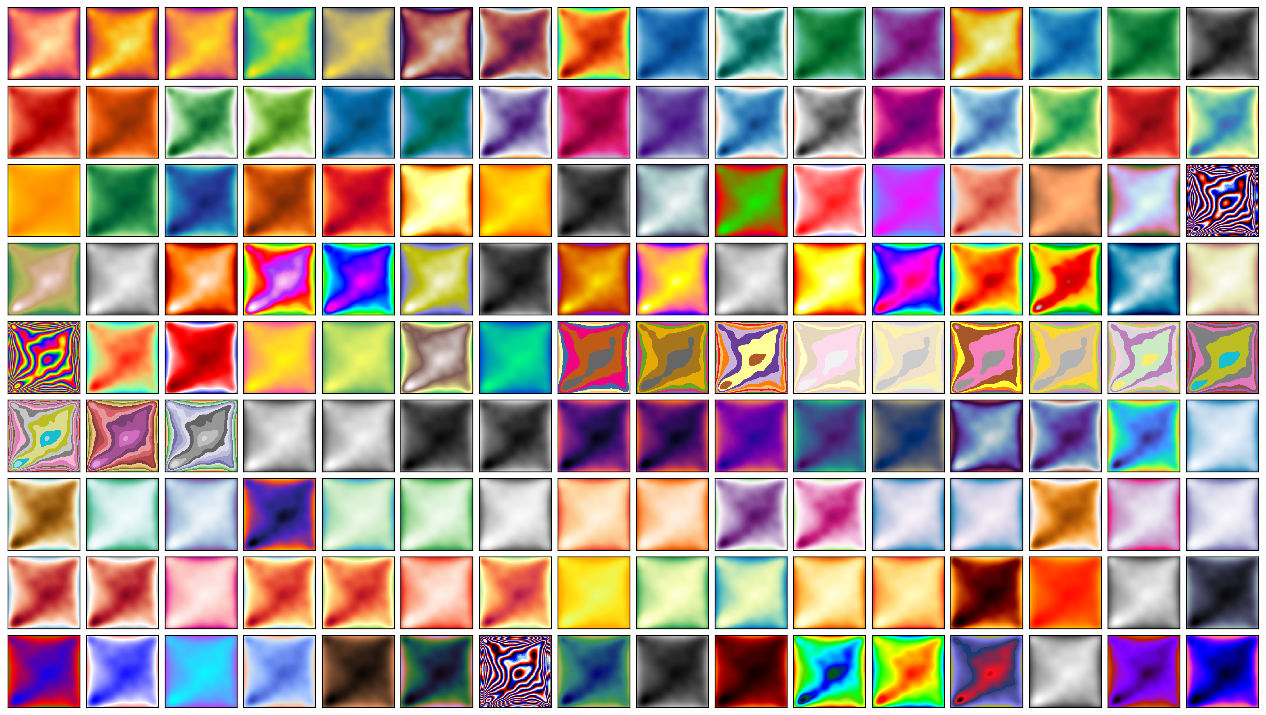
Data Visualization

Slide 2
TODO (for next year)
Do not mention kurtosis
Do not mention logarithmic scales (only mention logarithms in the feature engineering lecture)
The difference between outliers and fat tails is not clear
The “Numbers” slide is way too complex (they just learned Python)
Do not mention bivariate outliers
The distinction between “linear” and “nonlinear” was not clear to them.
Multivariate boxplot: rescale wrt the median
They seem to like the violin plot: ditch the boxplot in its favour?
Add a summary slide “PCA vs UMAP”: PCA preserved directions, UMAP highlights clusters
There is not enough time to cover time series
Add a different exercise for the “multivariate data” section
Afternoon exercise: too open-ended. Instead, ask them to reproduce a plot?
Gapminder: time series plots? Animation?
Automatic EDA: demo?
Put the exercises in separate notebooks: all the dataframes are called “d” and, since they can run the cells in an arbitrary order, they often end up with the wrong one…

Slide 3
Data Visualization

Slide 4
Exploratory Data Analysis

Slide 5
Goals of EDA
Find problems
Understand
Communicate

Slide 6
Agenda
Univariate data
Quantitative vs qualitative
Bivariate data
Multivariate data
Unstructured data
Potential problems
Numbers (“dataset features”)
Plots

Slide 7
Agenda
Univariate data
Quantitative vs qualitative
Bivariate data
Multivariate data
Unstructured data
Potential problems
Numbers (“dataset features”)
Plots

Slide 8
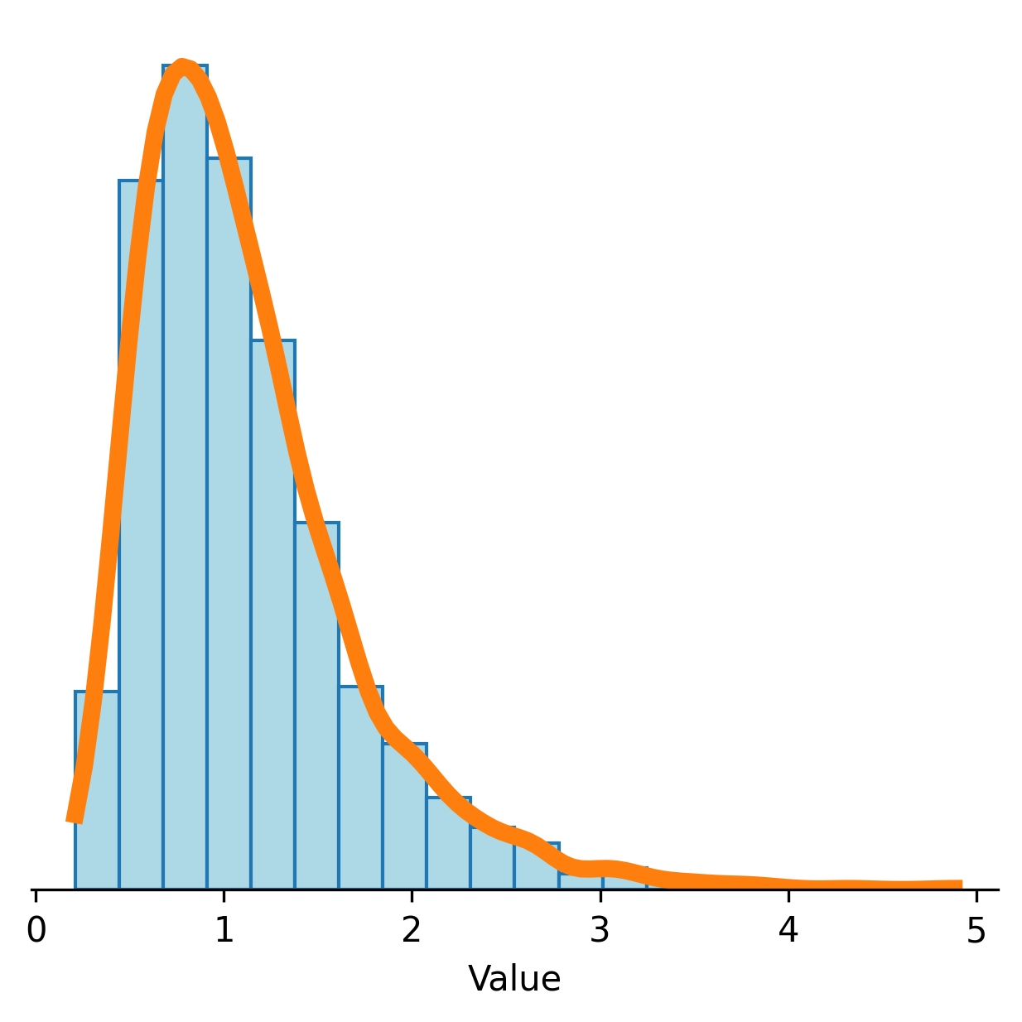
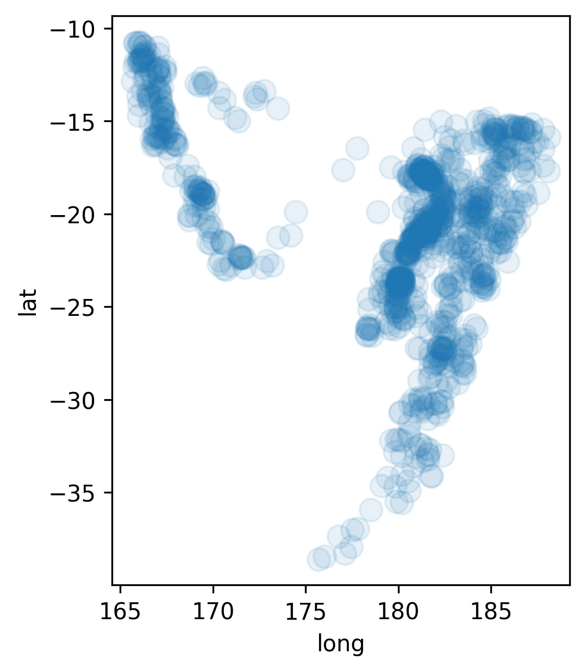
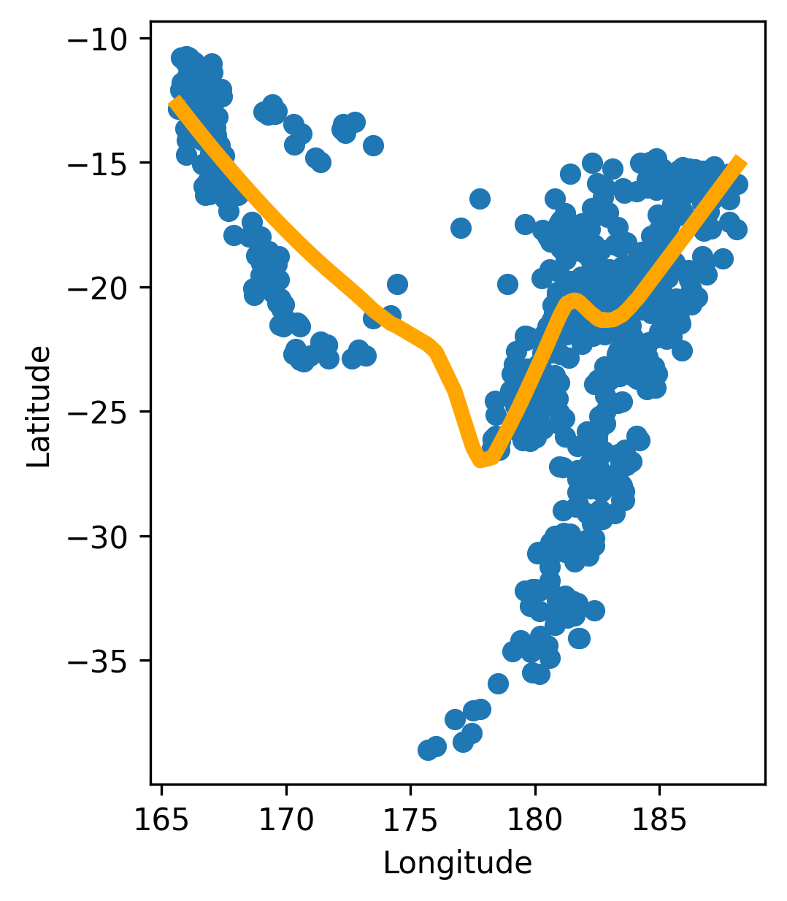
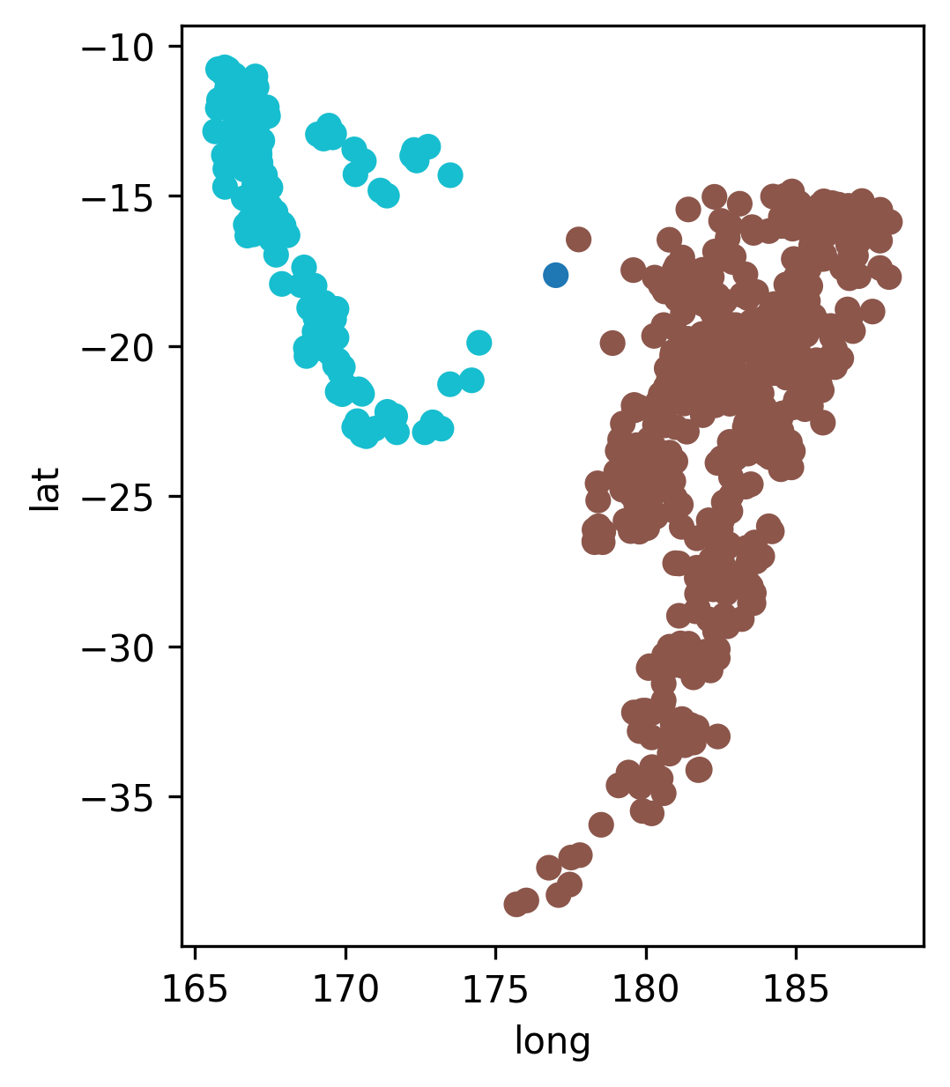
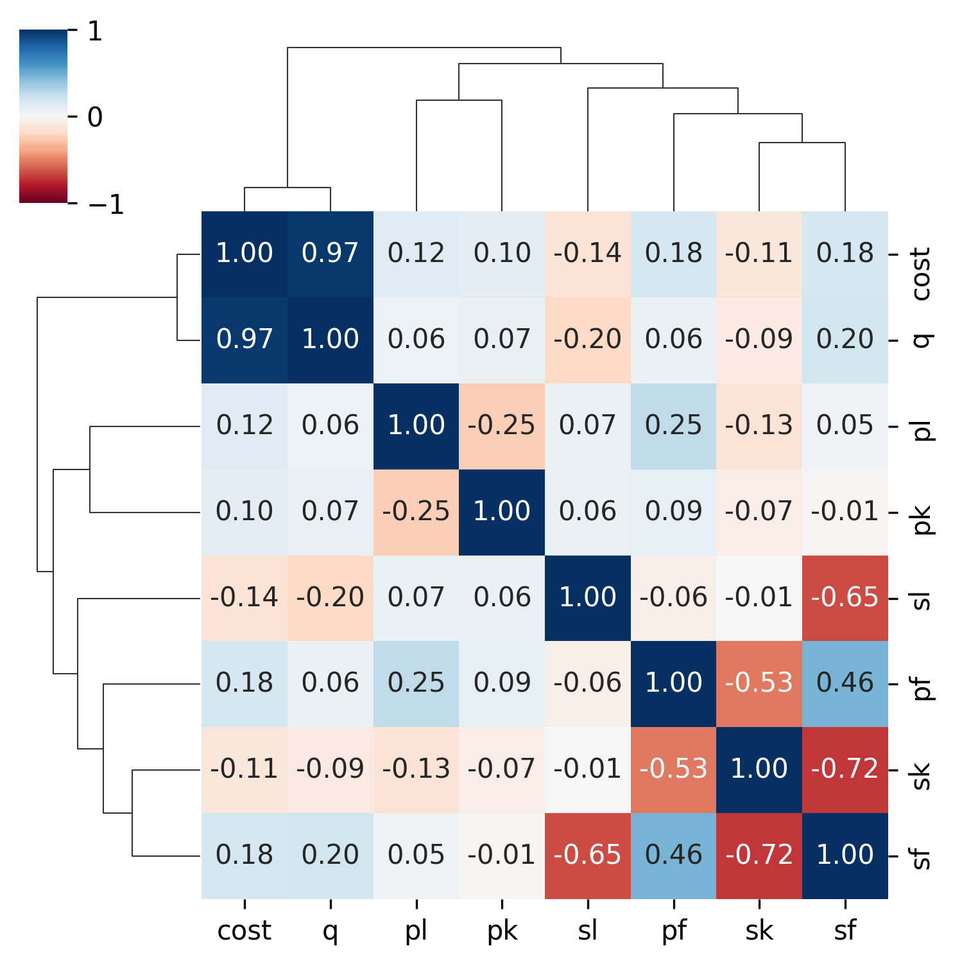
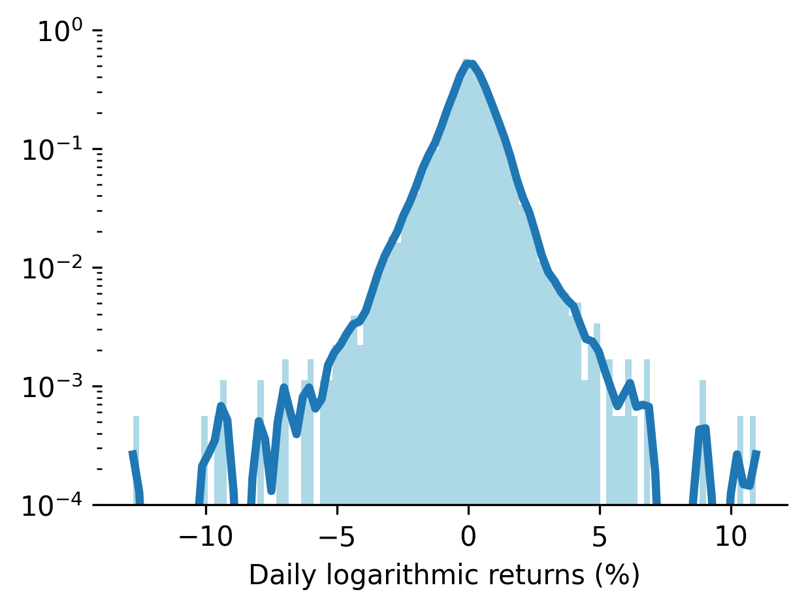
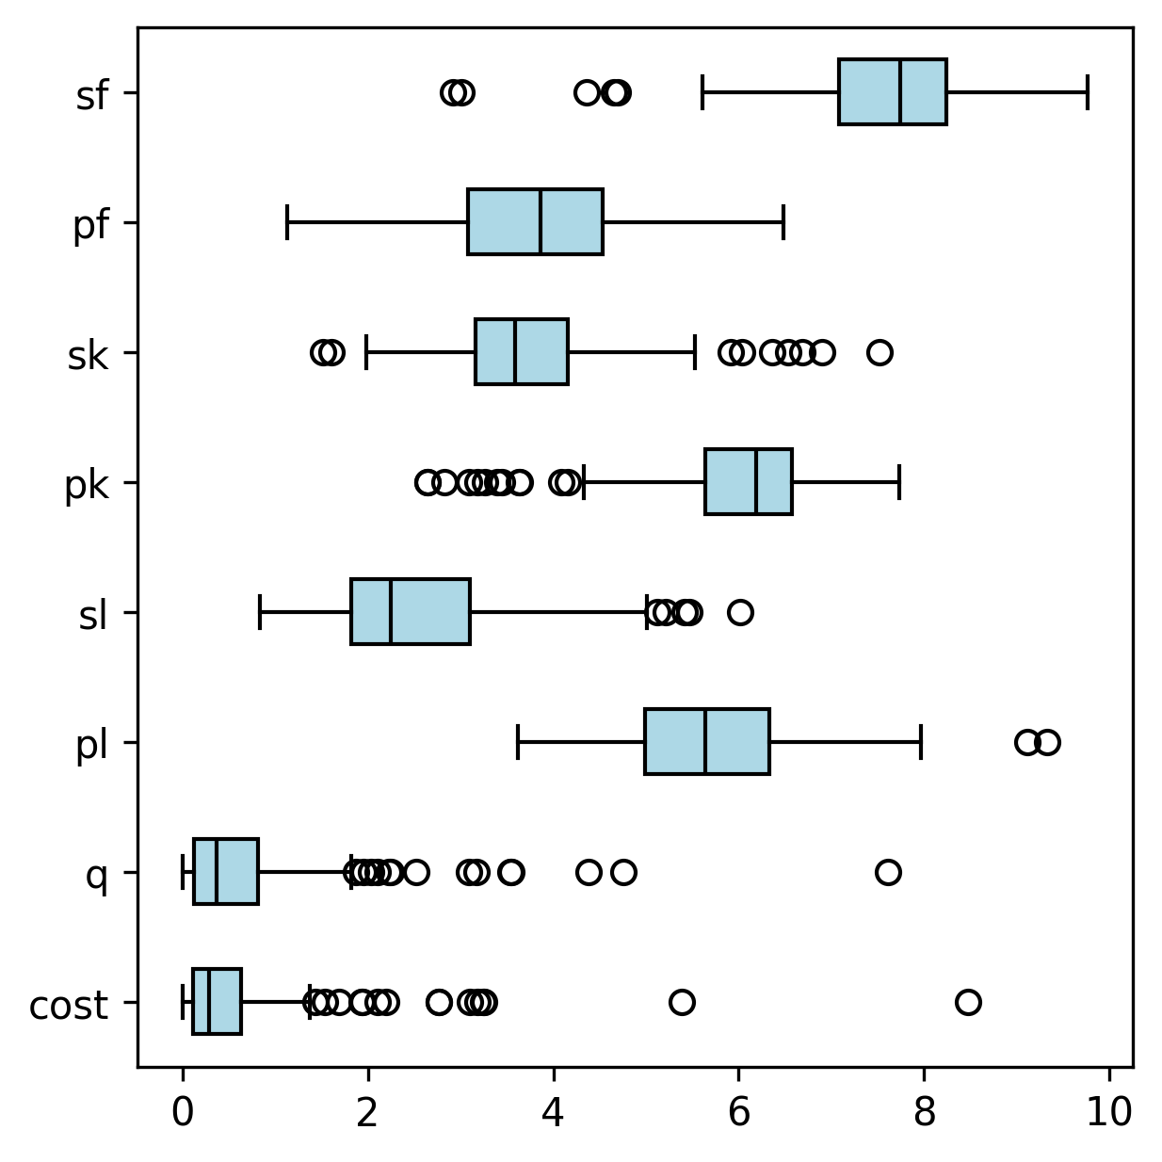
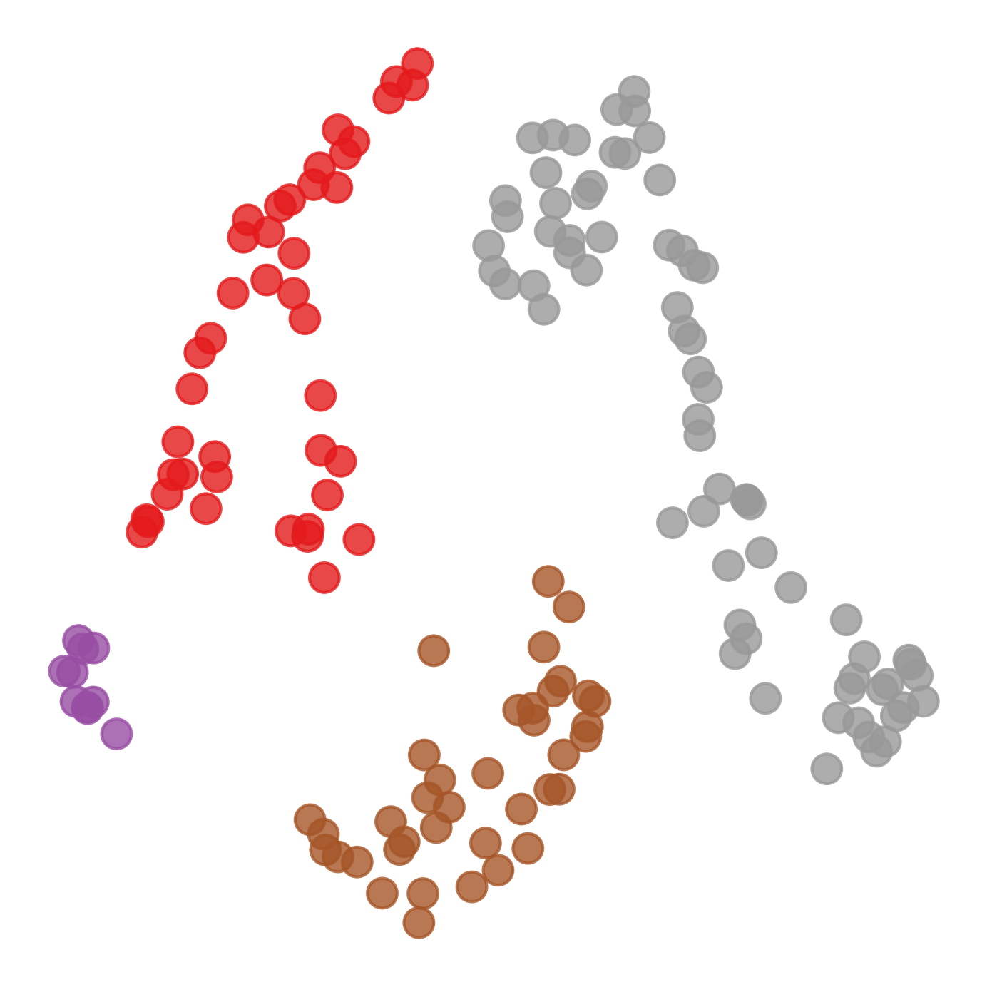
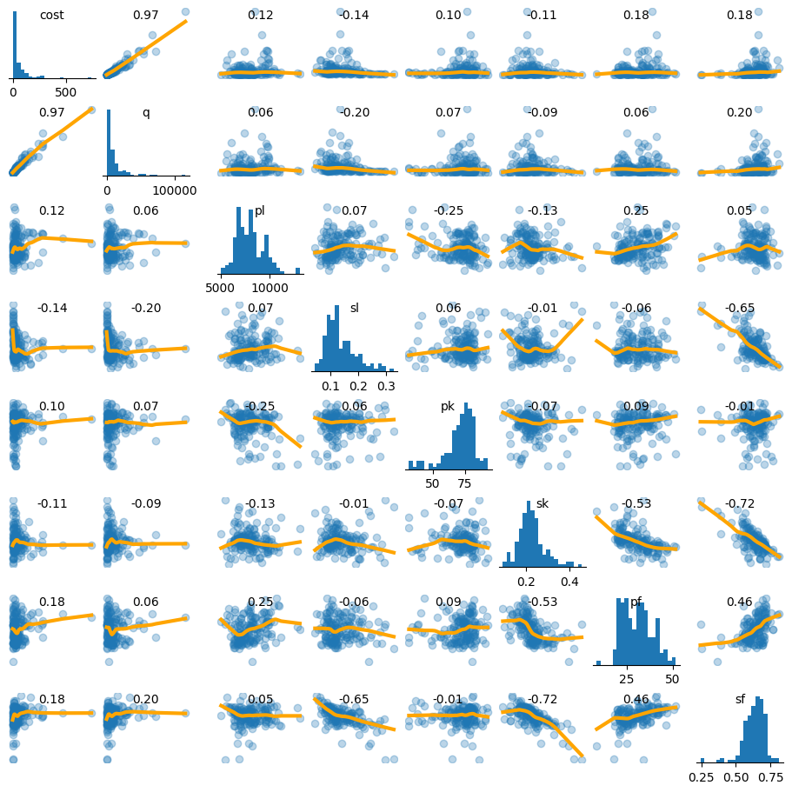
Agenda

Slide 9
Plotting

Slide 10
Plotting libraries
Pandas d.plot.hist d.plot.scatter …
Matplotlib plt.hist plt.scatter …
Seaborn sns.histplot sns.scatterplot …
Many more: plotly, etc.

Slide 11
Plotting libraries
Pandas d.plot.hist d.plot.scatter …
Matplotlib plt.hist plt.scatter …
Seaborn sns.histplot sns.scatterplot …
Many more: plotly, etc.

Slide 12
import numpy as np
import pandas as pd
import matplotlib.pyplot as plt
import seaborn as sns
import scipy, sklearn, statsmodels
from collections import Counter

Slide 13
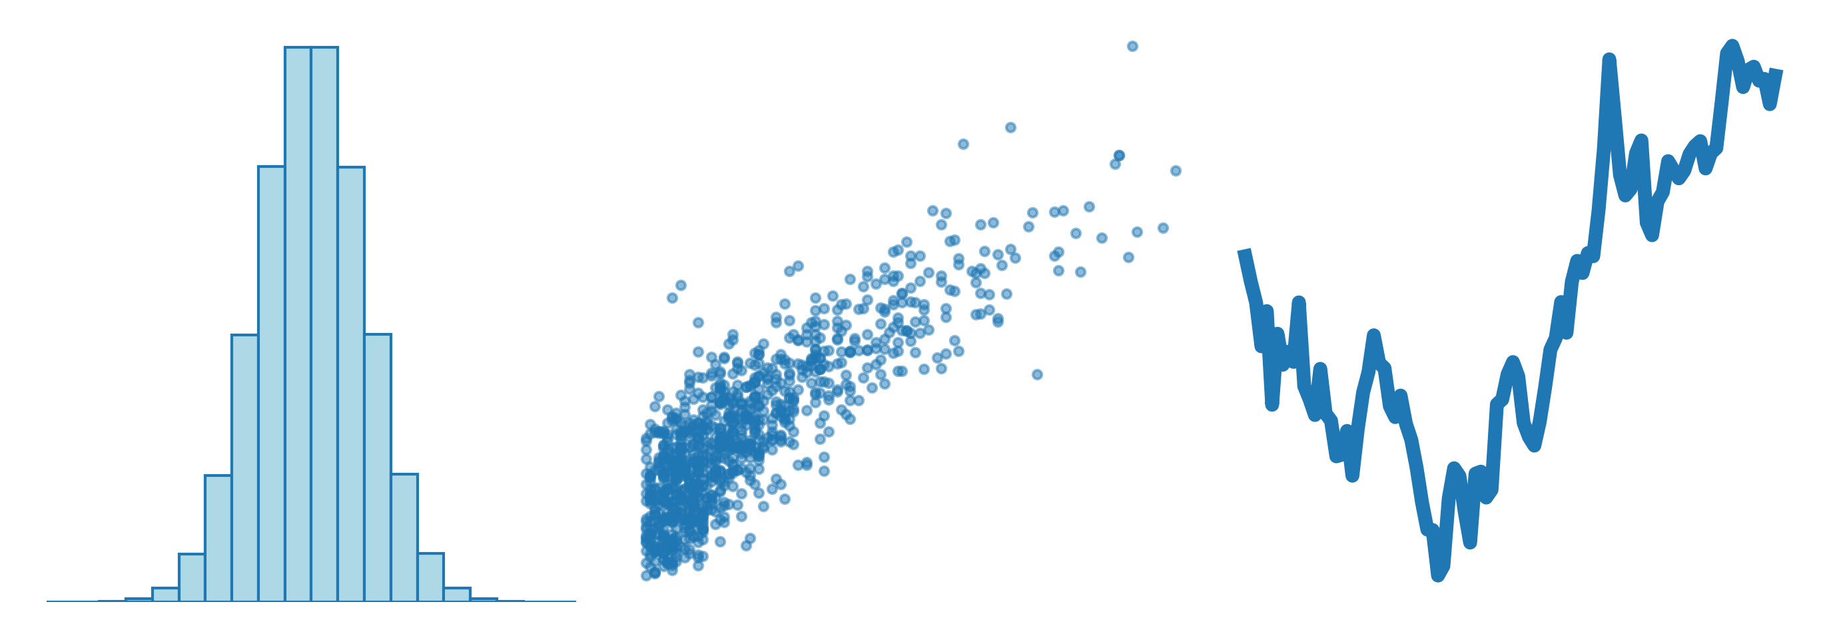
Matplotlib
histogram
scatter plot
line chart
plt.hist(x) plt.scatter(x,y) plt.plot(x,y)

Slide 14
Pandas
histogram
scatter plot
line chart
x.plot.hist(x) d.plot.scatter("x","y") x.plot()

Slide 15
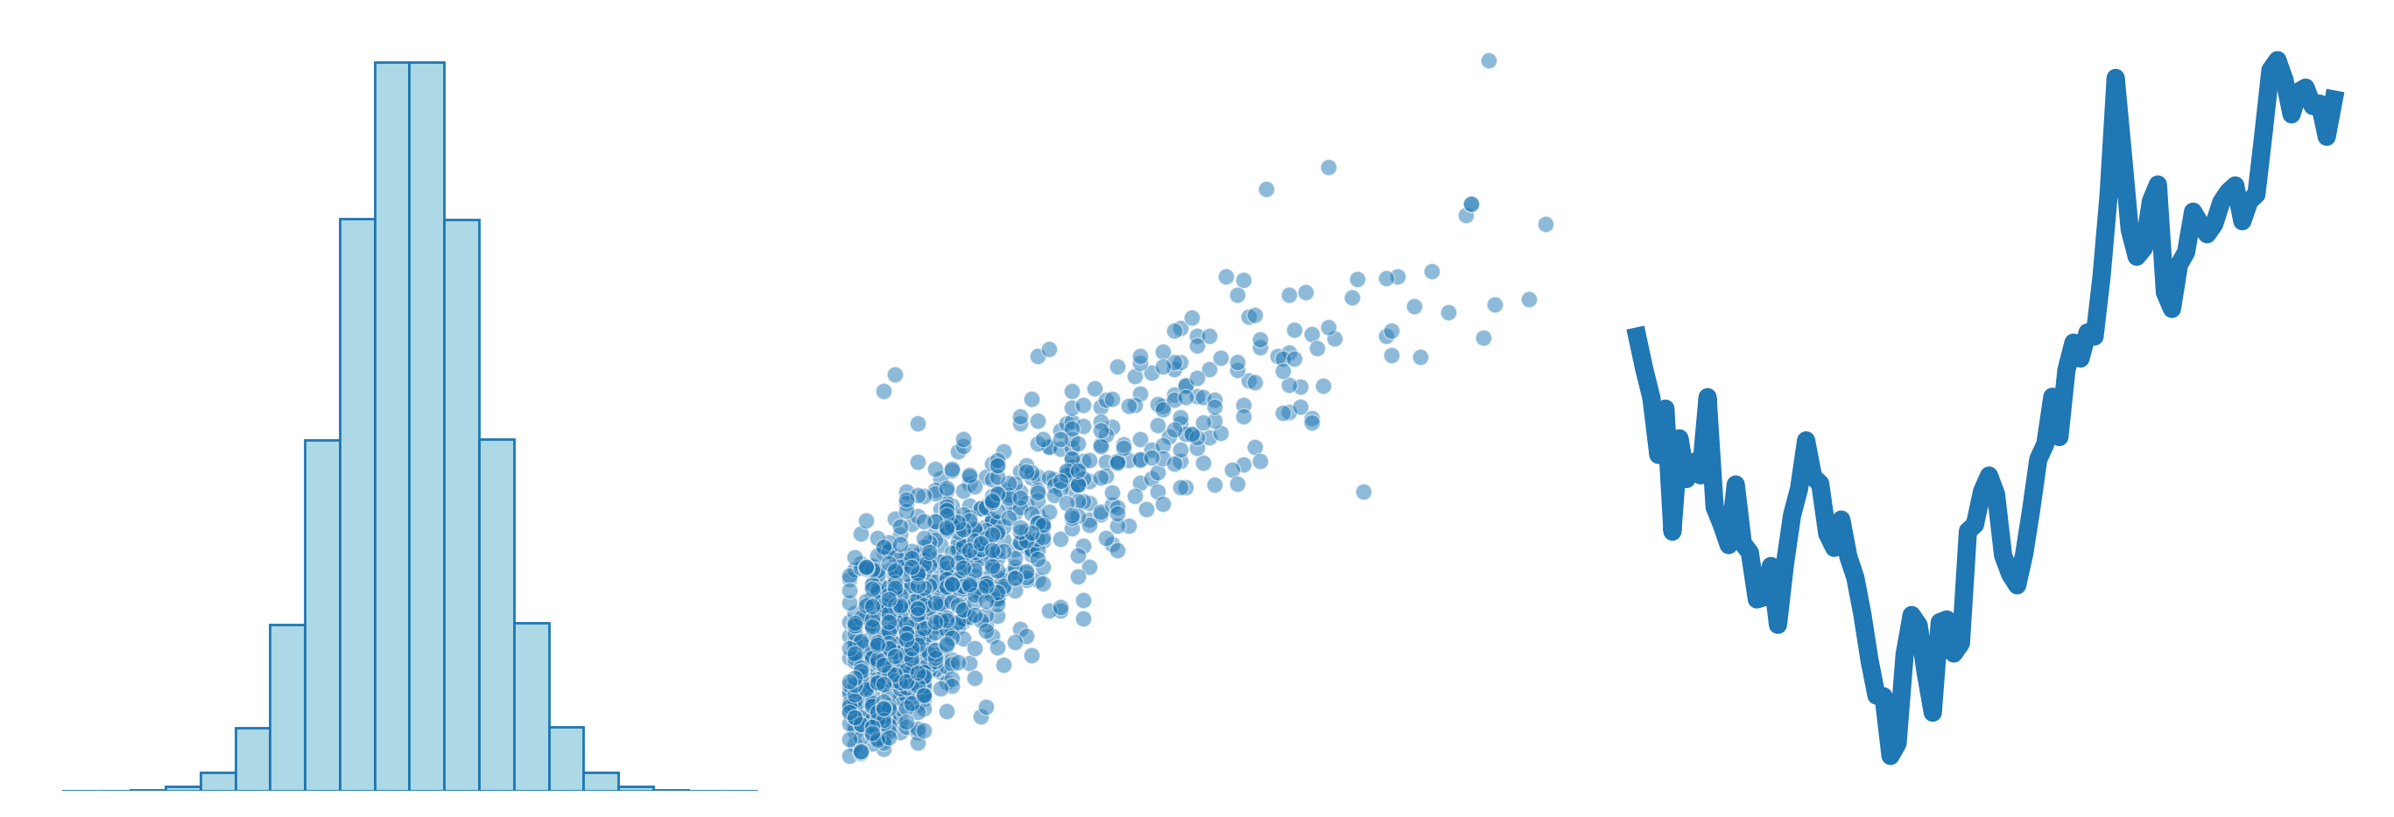
Seaborn
histogram
scatter plot
line chart
sns.histplot(x) sns.scatterplot(d,x="x",y="y") sns.lineplot(x)

Slide 16
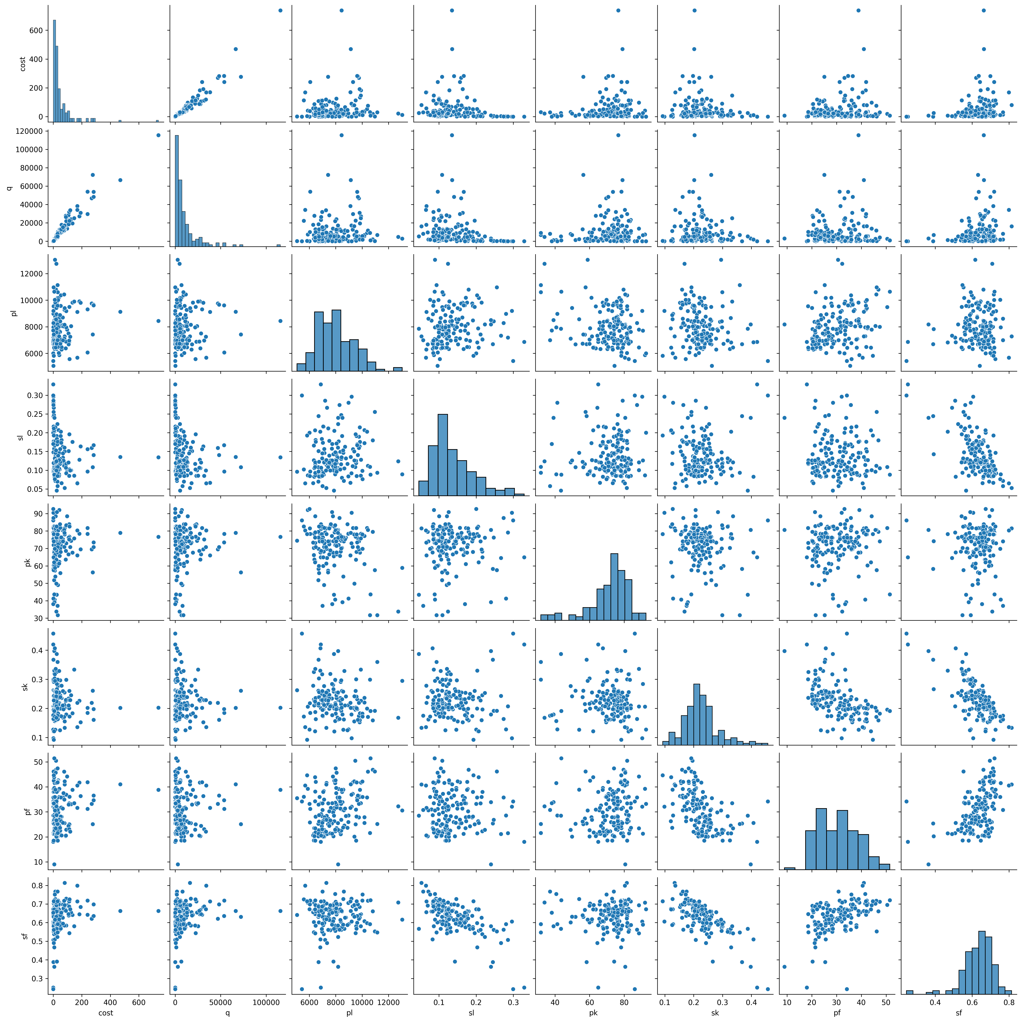
Seaborn
correlation matrix pair plot
sns.clustermap(d.corr(),...) sns.pairplot(d)

Slide 17
For more complex plots
Check the Matplotlib or Seaborn galleries (for inspiration, or to find the name of a plot) show the live websites
Ask ChatGPT (but check and fix its answers)

Slide 18
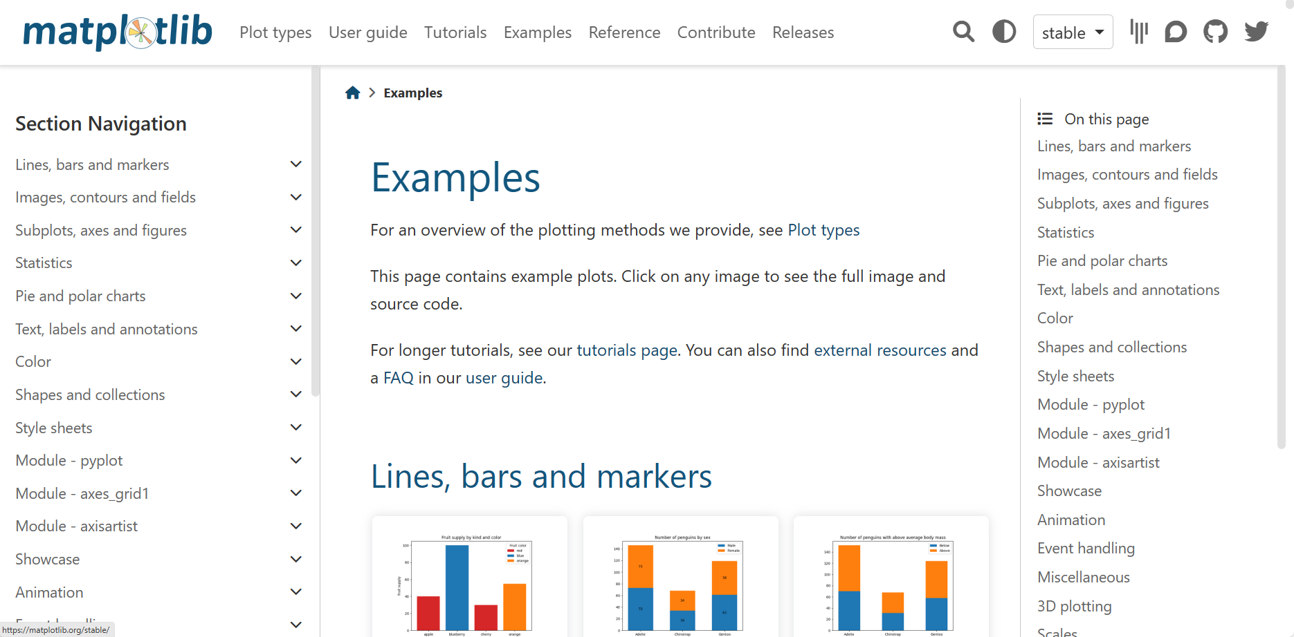

Slide 19
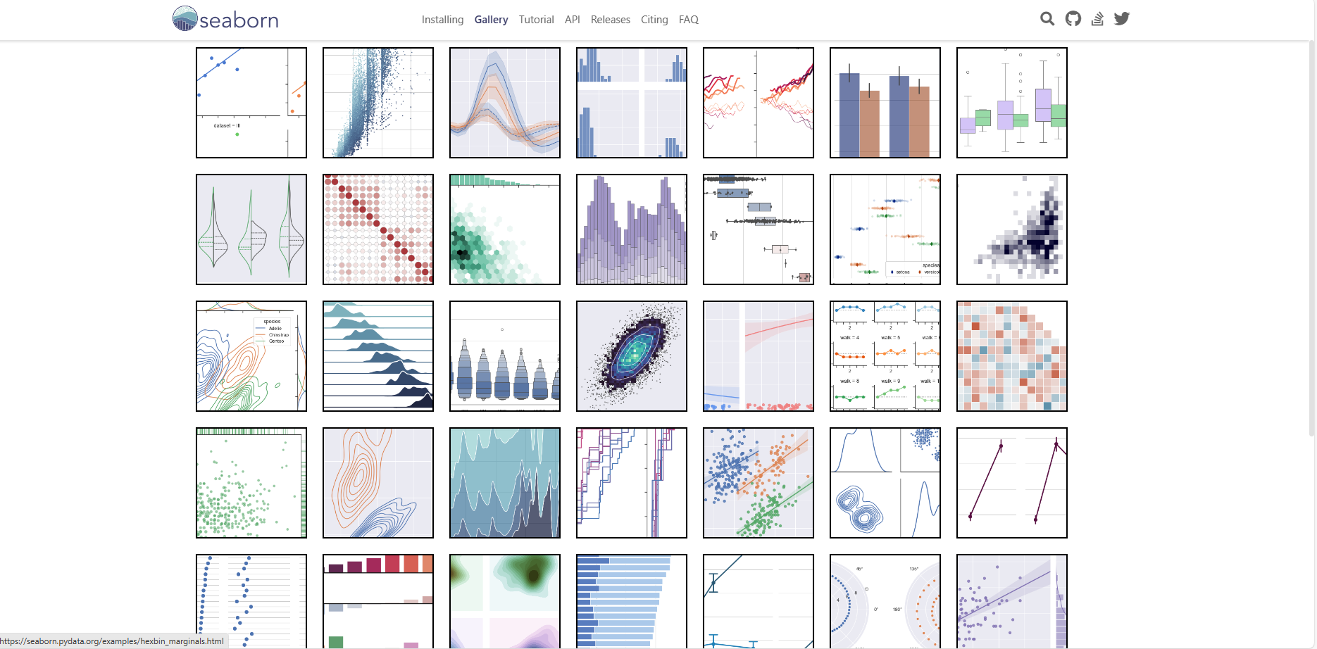

Slide 20
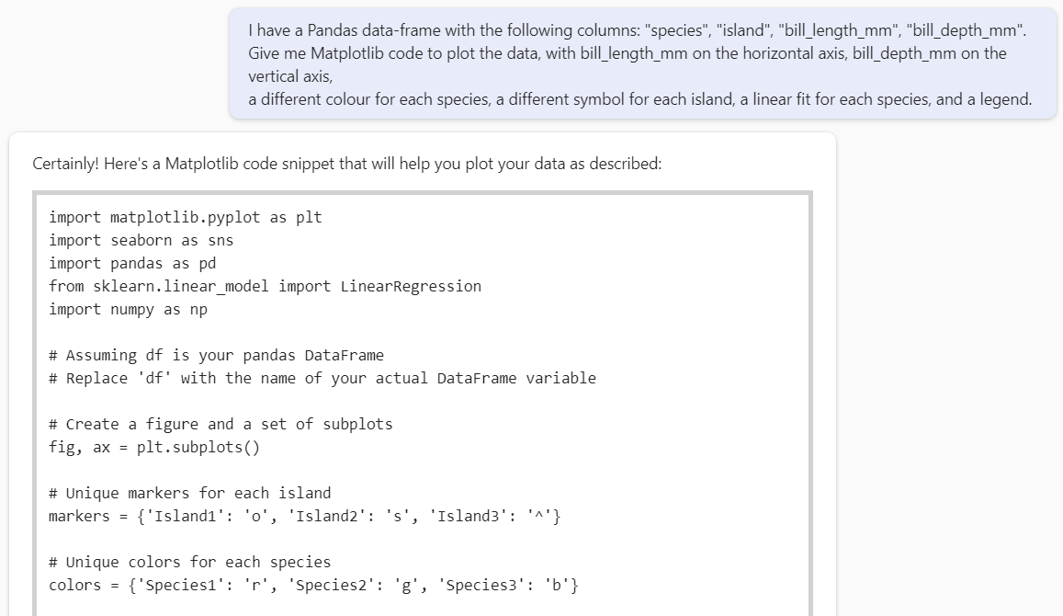

Slide 21
import matplotlib.pyplot as plt
import seaborn as sns
import pandas as pd
from sklearn.linear_model import LinearRegression
import numpy as np
# Assuming df is your pandas DataFrame
# Replace 'df' with the name of your actual DataFrame variable
# Create a figure and a set of subplots
fig, ax = plt.subplots()
# Unique markers for each island
markers = {'Island1': 'o', 'Island2': 's', 'Island3': '^'}
# Unique colors for each species
colors = {'Species1': 'r', 'Species2': 'g', 'Species3': 'b'}
# Plot each species
for species in df['species'].unique():
for island in df['island'].unique():
species_island_df = df[(df['species'] == species) & (df['island'] == island)]
sns.regplot(x='bill_length_mm', y='bill_depth_mm', data=species_island_df,
scatter_kws={'color': colors[species], 'marker': markers[island]},
line_kws={'color': colors[species], 'label': f'Linear fit for {species}'},
ax=ax)
# Set the labels for the axes
ax.set_xlabel('Bill Length (mm)')
ax.set_ylabel('Bill Depth (mm)')
# Add a legend
ax.legend()
# Show the plot
plt.show()

Slide 22
import matplotlib.pyplot as plt
import seaborn as sns
import pandas as pd
from sklearn.linear_model import LinearRegression
import numpy as np
# Assuming df is your pandas DataFrame
# Replace 'df' with the name of your actual DataFrame variable
# Create a figure and a set of subplots
fig, ax = plt.subplots()
# Unique markers for each island
markers = {'Island1': 'o', 'Island2': 's', 'Island3': '^'}
# Unique colors for each species
colors = {'Species1': 'r', 'Species2': 'g', 'Species3': 'b'}
# Plot each species
for species in df['species'].unique():
for island in df['island'].unique():
species_island_df = df[(df['species'] == species) & (df['island'] == island)]
sns.regplot(x='bill_length_mm', y='bill_depth_mm', data=species_island_df,
scatter_kws={'color': colors[species], 'marker': markers[island]},
line_kws={'color': colors[species], 'label': f'Linear fit for {species}'},
ax=ax)
# Set the labels for the axes
ax.set_xlabel('Bill Length (mm)')
ax.set_ylabel('Bill Depth (mm)')
# Add a legend
ax.legend()
# Show the plot
plt.show()

Slide 23
import matplotlib.pyplot as plt
import seaborn as sns
import pandas as pd
from sklearn.linear_model import LinearRegression
import numpy as np
# Assuming df is your pandas DataFrame
# Replace 'df' with the name of your actual DataFrame variable
# Create a figure and a set of subplots
fig, ax = plt.subplots()
# Unique markers for each island
markers = {'Biscoe': 'o', 'Dream': 's', 'Torgersen': '^'}
# Unique colors for each species
colors = {'Adelie': 'r', 'Chinstrap': 'g', 'Gentoo': 'b'}
# Plot each species
for species in df['species'].unique():
for island in df['island'].unique():
species_island_df = df[(df['species'] == species) & (df['island'] == island)]
sns.regplot(x='bill_length_mm', y='bill_depth_mm', data=species_island_df,
scatter_kws={'color': colors[species], 'marker': markers[island]},
line_kws={'color': colors[species], 'label': f'Linear fit for {species}'},
ax=ax)
# Set the labels for the axes
ax.set_xlabel('Bill Length (mm)')
ax.set_ylabel('Bill Depth (mm)')
# Add a legend
ax.legend()
# Show the plot
plt.show()

Slide 24
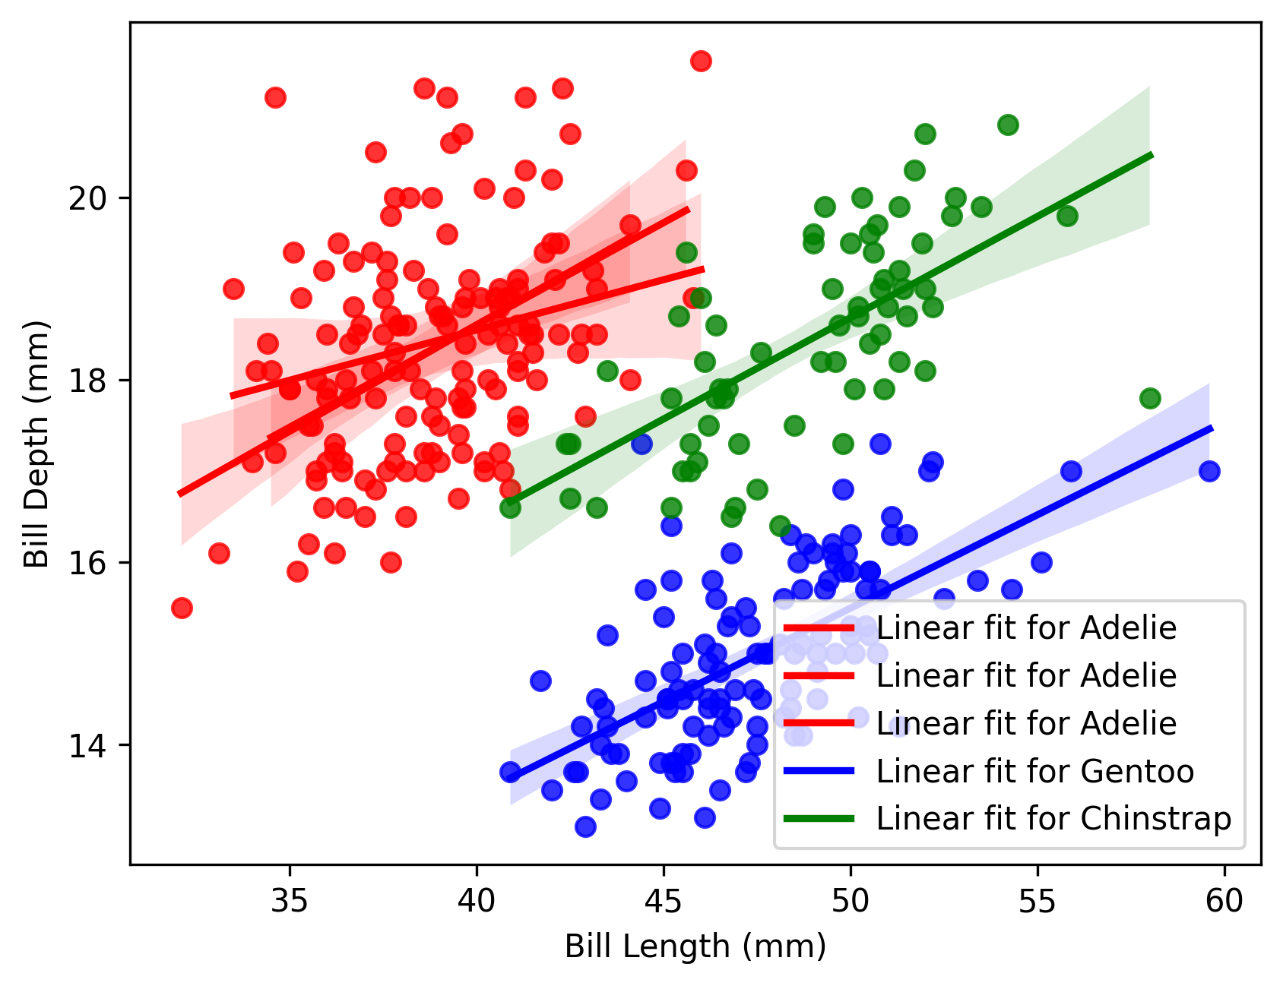

Slide 25
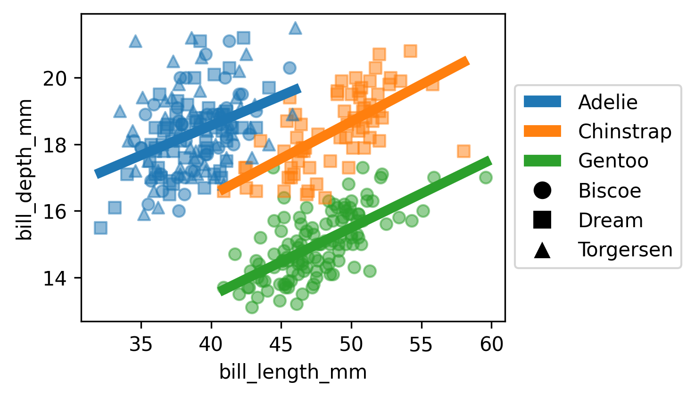

Slide 26
Univariate Data

Slide 27
Univariate Data
A list of numbers, e.g., [ 0.51, 0.31, 0.03, ..., 1.11, -0.19, -0.29]

Slide 28
Potential problems
Data types
Missing values
Magic numbers
Zero inflation
Outliers
Fat tails
Skewness
Multimodality

Slide 29
Potential Problems
["1", "2", "17.3", "N/A", ...]
["15,271", "517", "32.1", "184,236", ...]
["14%", "17%", "65%", "3%", ...]
[17, 33, 18, 25, nan, 51, ...]
[17, 33, 18, 25, -1, 51, ...]
[17, 33, 18, 25, 999, 51, ...]
[17, 33, 18, 25, None, 51, ...]

Slide 30
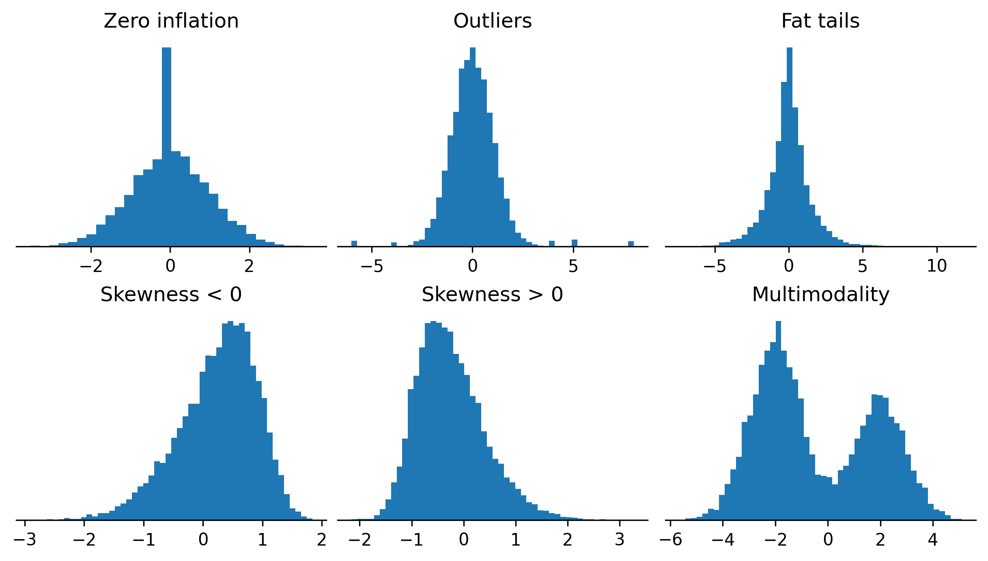
Potential problems

Slide 31
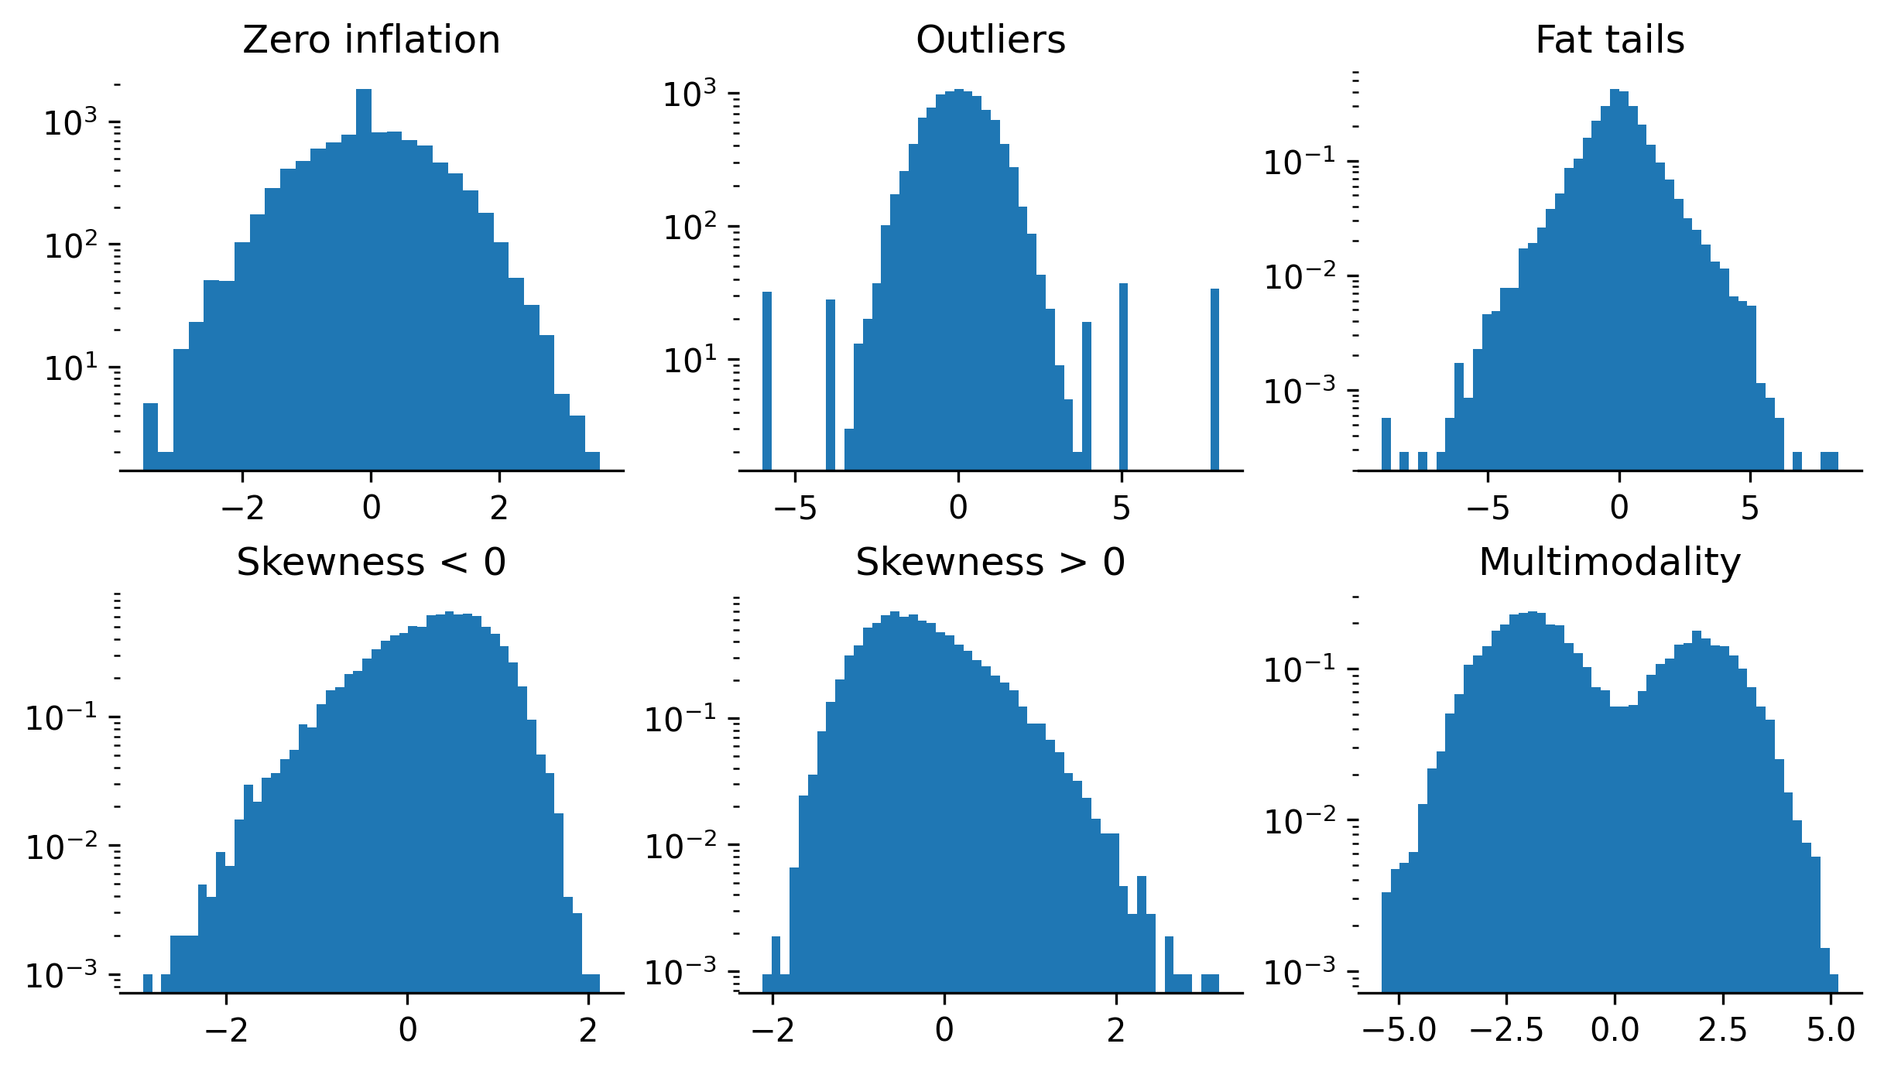

Slide 32
Numbers
Number of observations
Number of missing values
Mode (value and number of repeats)
Number of zeroes
Minimum, maximum
Mean
Median
Standard deviation
Quantiles
Inter-quartile range
Skewness
Kurtosis

Slide 33
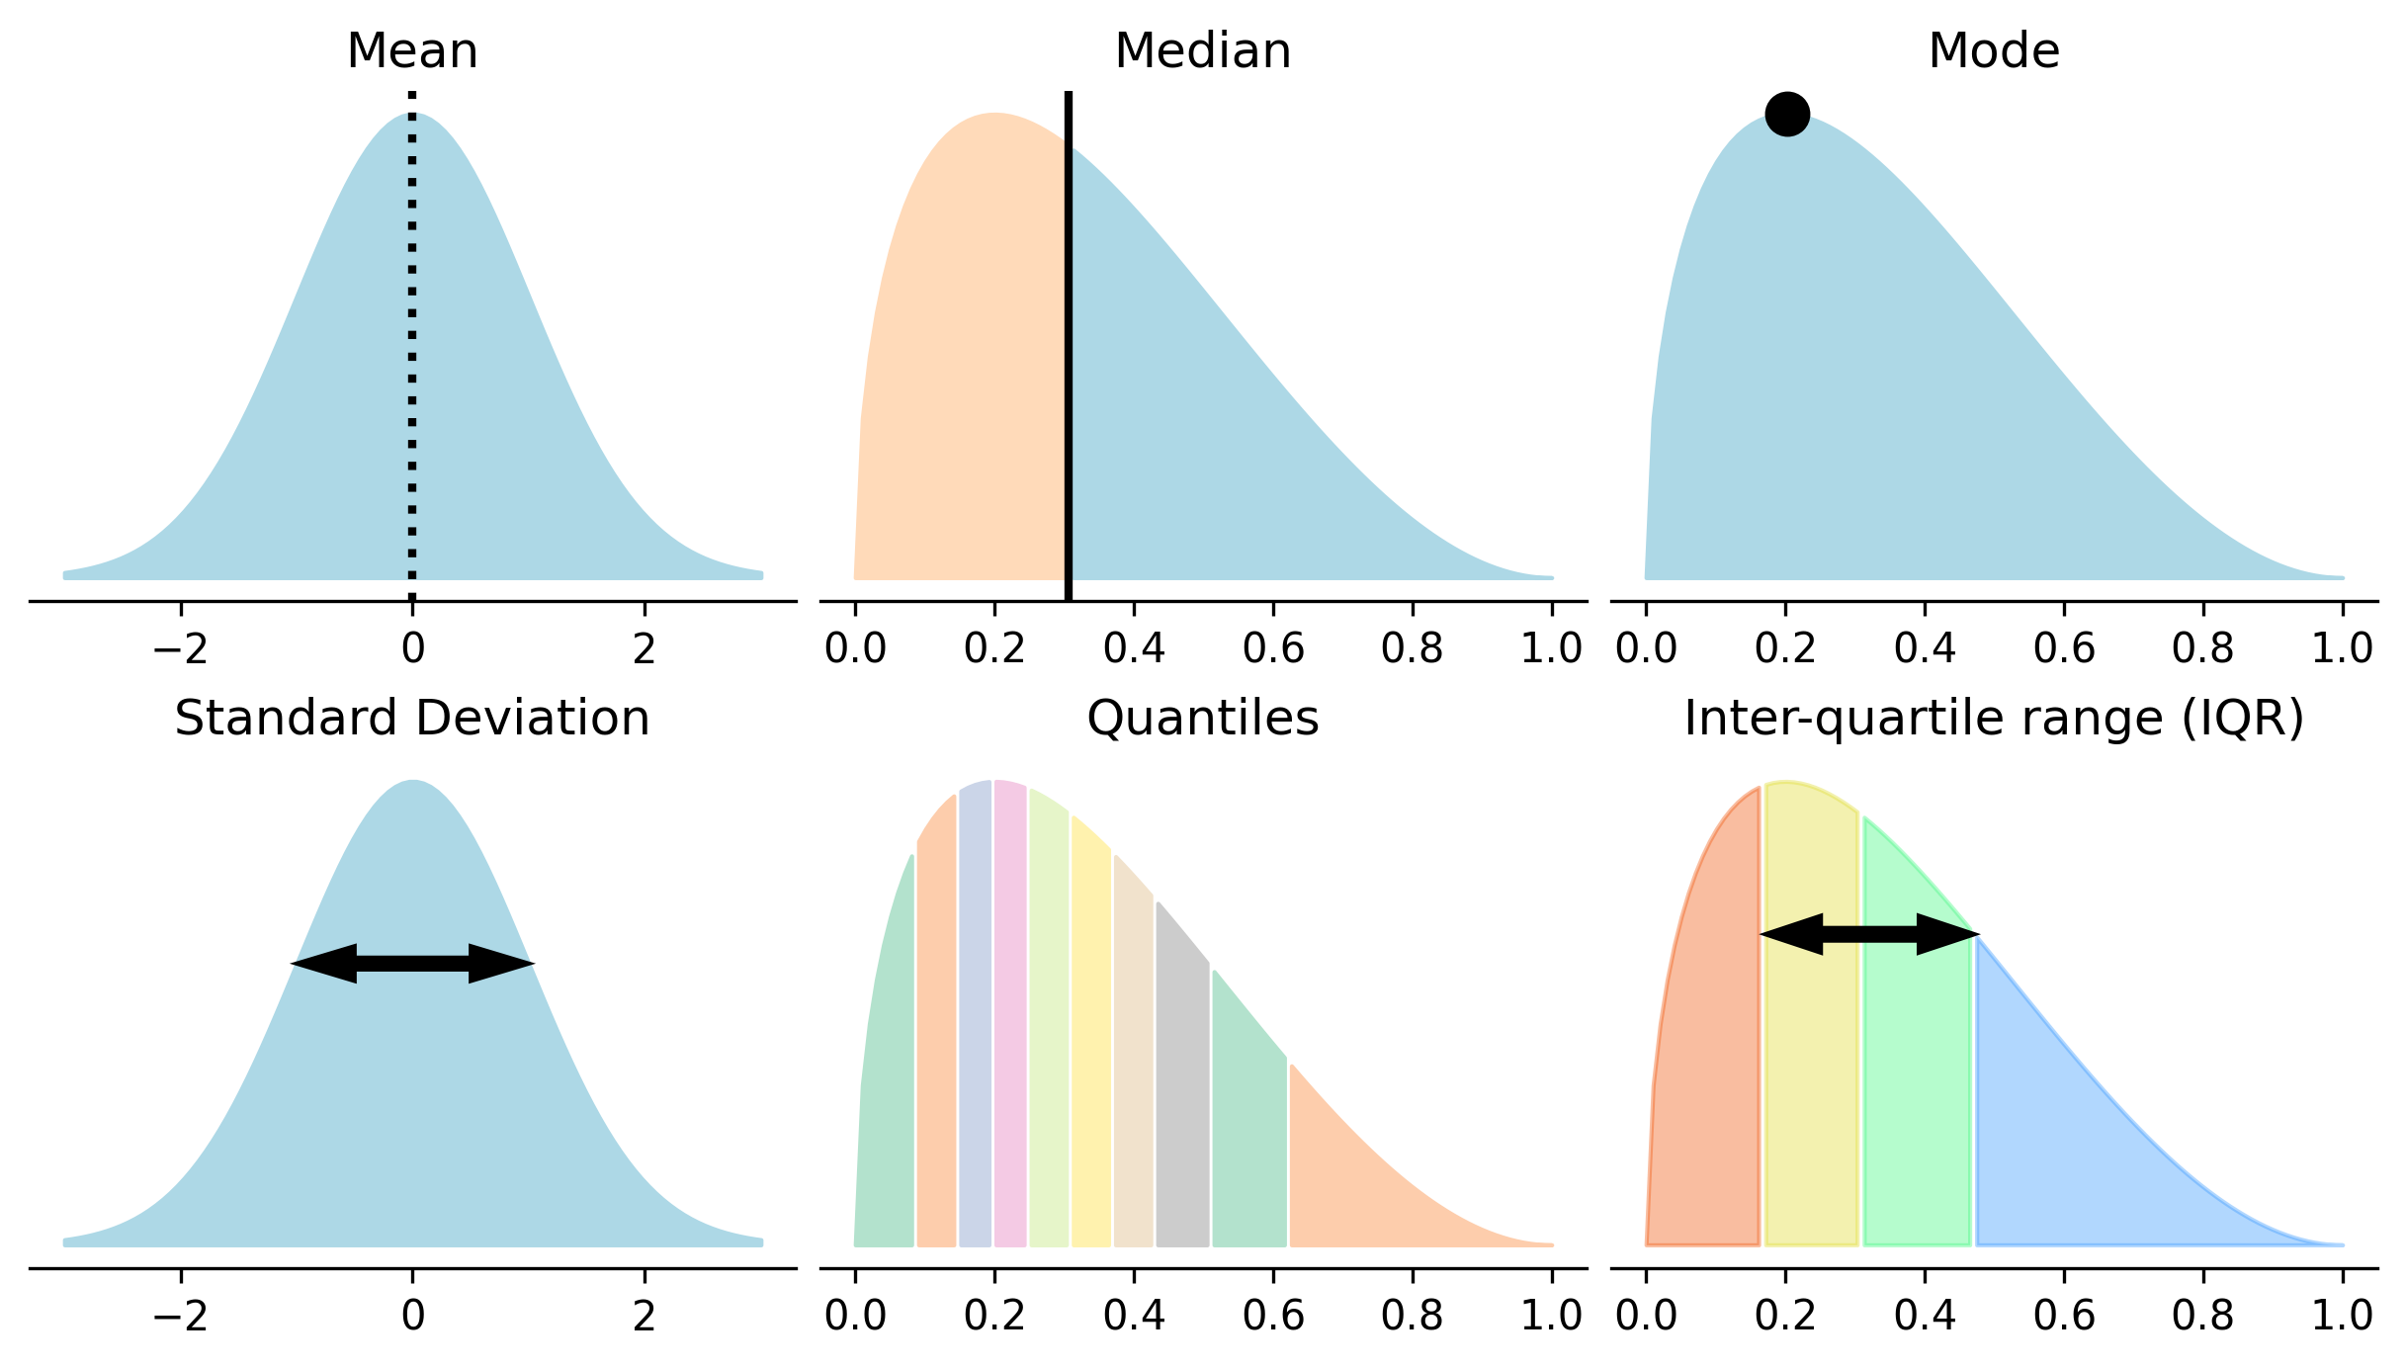

Slide 34
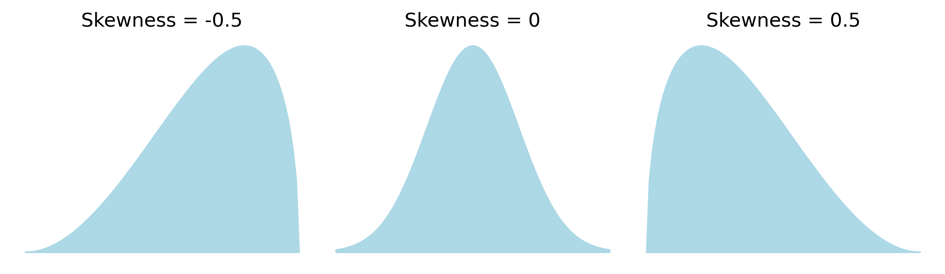

Slide 35
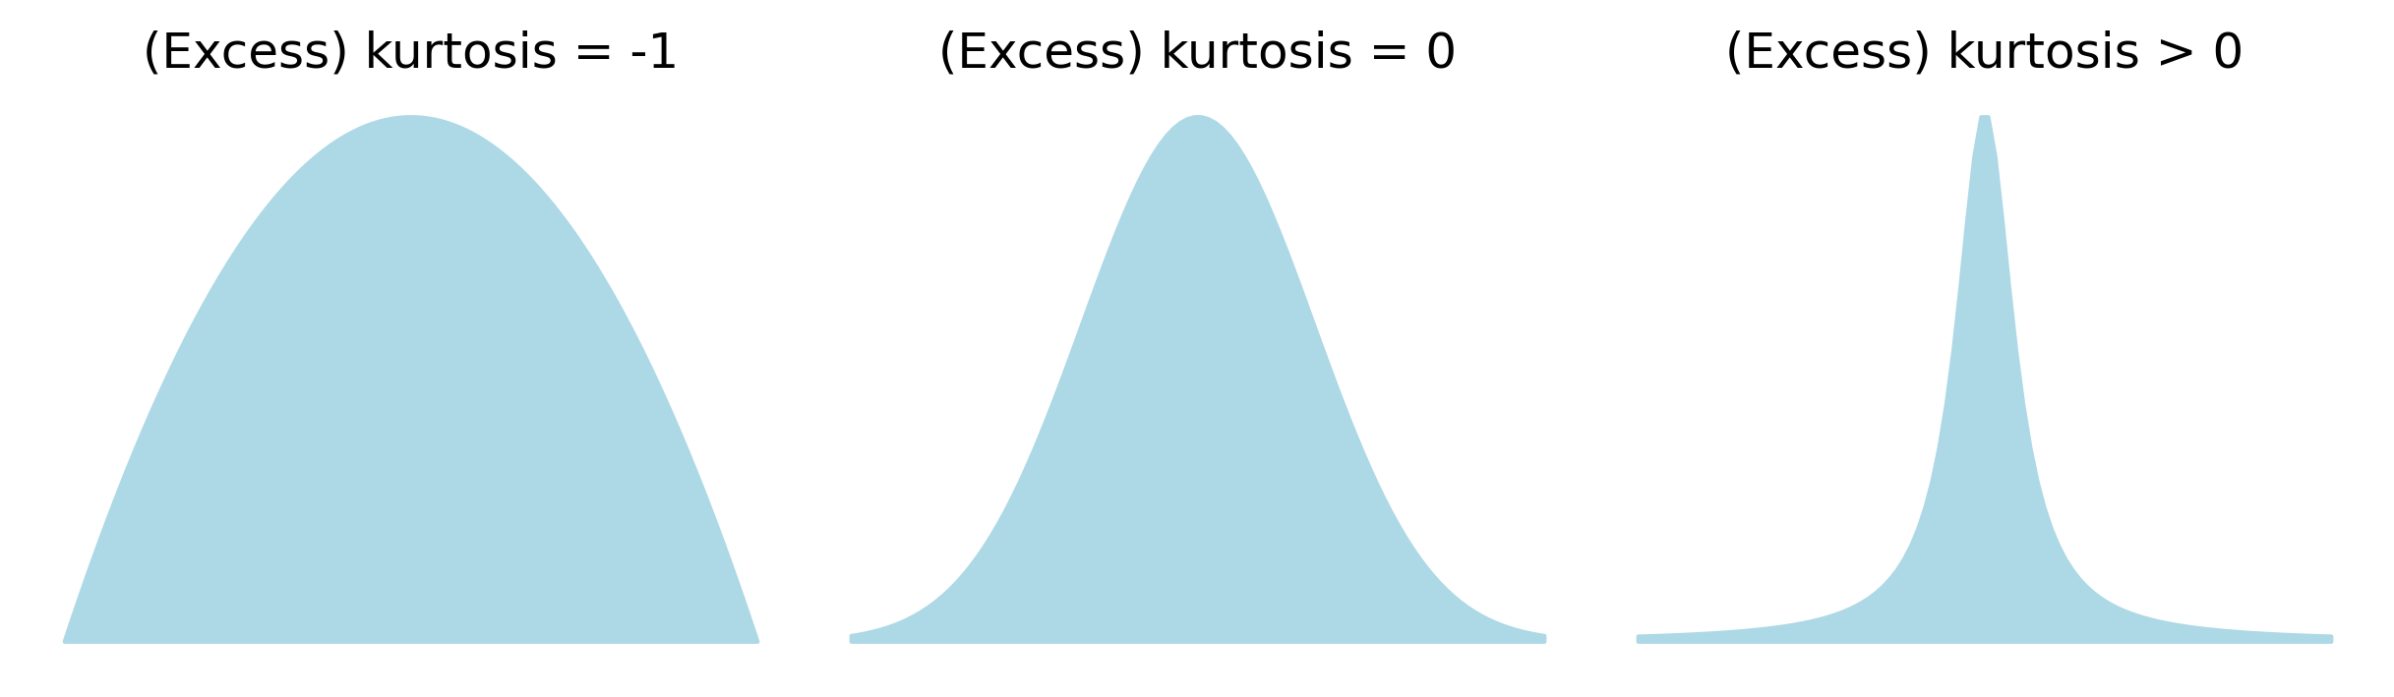

Slide 36
Numbers
x.describe()
count 272.000000 mean 70.897059 std 13.594974 min 43.000000 25% 58.000000 50% 76.000000 75% 82.000000 max 96.000000 Name: waiting, dtype: float64

Slide 37
Numbers
{
'dtype': str(x.dtype),
'observations': len(x),
'missing': x.isnull().sum(),
'mode': list(x.mode()),
'mode occurrences': ( x == x.mode()[0] ).sum(),
'zeroes': (x == 0).sum(),
'mean': x.mean(),
'median': x.median(),
'standard deviation': x.std(),
'inter-quartile range’: x.quantile([.25,.75]).diff().iloc[-1],
'skewness': x.skew(),
'kurtosis': x.kurt(),
'quantiles': list(x.quantile([.25,.5,.75])),
'min': x.min(),
'max': x.max(),
}

Slide 38
Numbers
{
'dtype': str(x.dtype),
'observations': len(x),
'missing': x.isnull().sum(),
'mode': list(x.mode()),
'mode occurrences': ( x == x.mode()[0] ).sum(),
'zeroes': (x == 0).sum(),
'mean': x.mean(),
'median': x.median(),
'standard deviation': x.std(),
'inter-quartile range’: x.quantile([.25,.75]).diff().iloc[-1],
'skewness': x.skew(),
'kurtosis': x.kurt(),
'quantiles': list(x.quantile([.25,.5,.75])),
'min': x.min(),
'max': x.max(),
}
{
'dtype': 'int64',
'observations’: 272,
'missing’: 0,
'mode’: [78],
'mode occurrences’: 15,
'zeroes’: 0,
'mean’: 70.90,
'median’: 76.0,
'standard deviation’: 13.59,
'inter-quartile range': 24.0,
'skewness’: -0.42,
'kurtosis’: -1.14,
'quantiles’: [58.0, 76.0, 82.0],
'min’: 43,
'max’: 96,
}

Slide 39
Plots
Boxplot
Histogram
Density, density with a logarithmic scale
Quantile-quantile plot

Slide 40
1.5×IQR
IQR
1.5×IQR
Q₁
median
Q₃
25%
25%
25%
25%

Slide 41
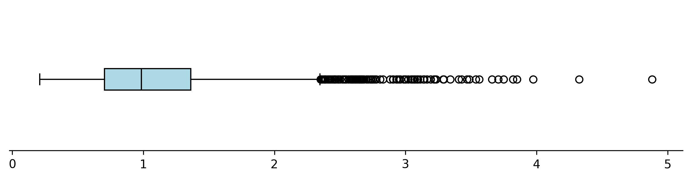
plt.boxplot(x)

Slide 42
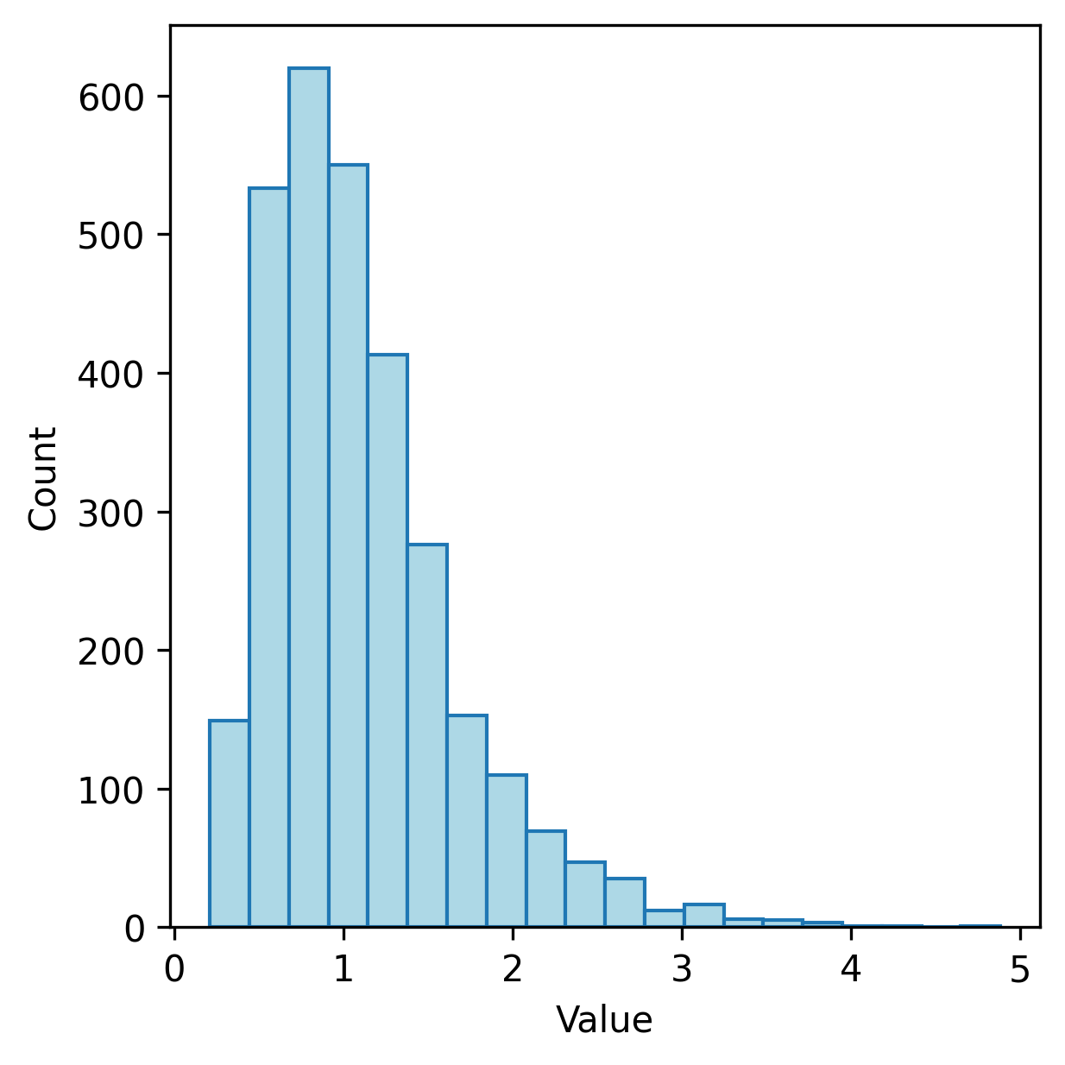
plt.hist(x)

Slide 43
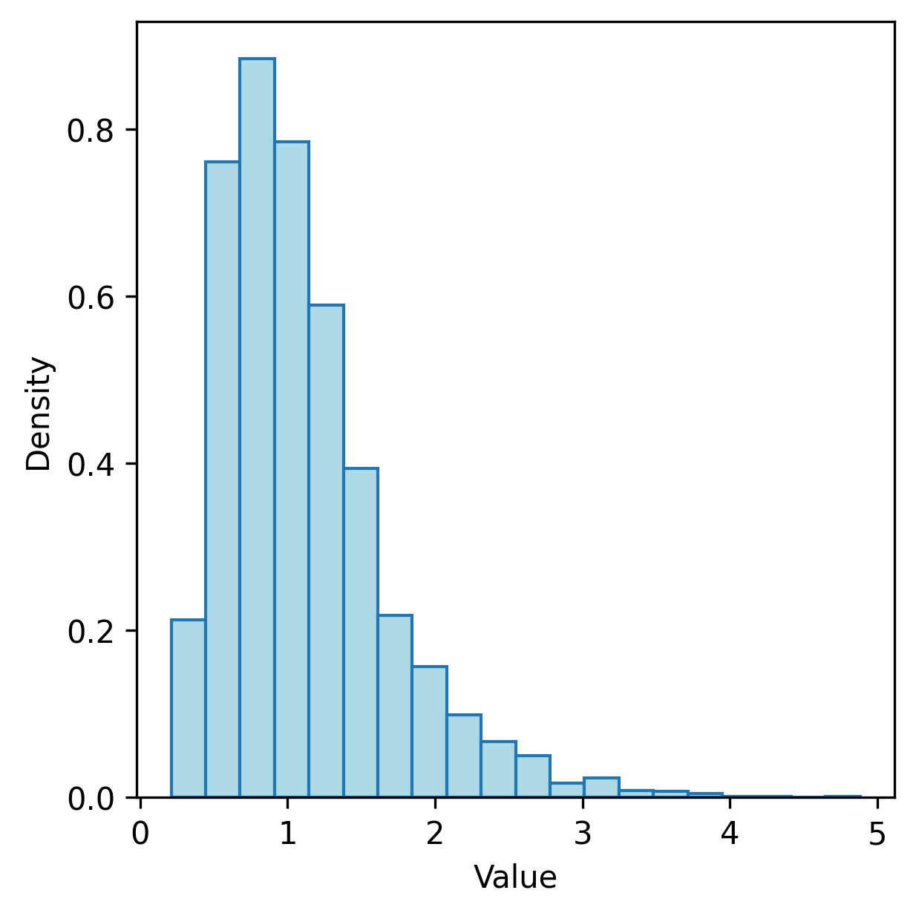
plt.hist(x, density=True)

Slide 44
x.plot.hist( density = True )
x.plot.density()

Slide 45
plt.hist( x, density = True )
xs = np.linspace(x.min(), x.max(), 100)
de = scipy.stats.gaussian_kde(x)
ys = de(xs)
plt.plot( xs, ys, linewidth = 5 )

Slide 46
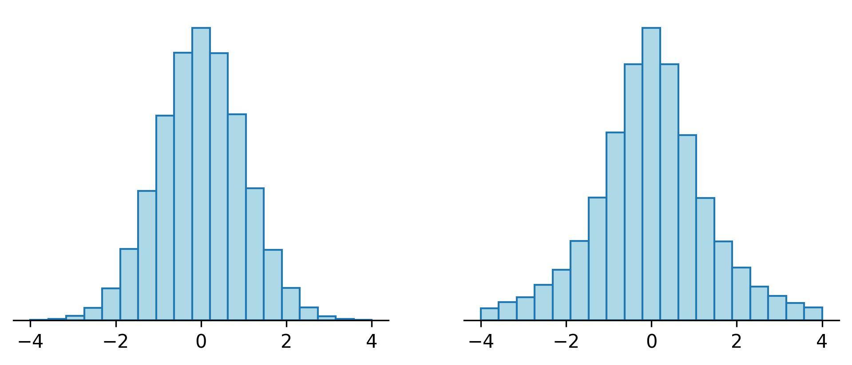
Can you spot the difference?

Slide 47
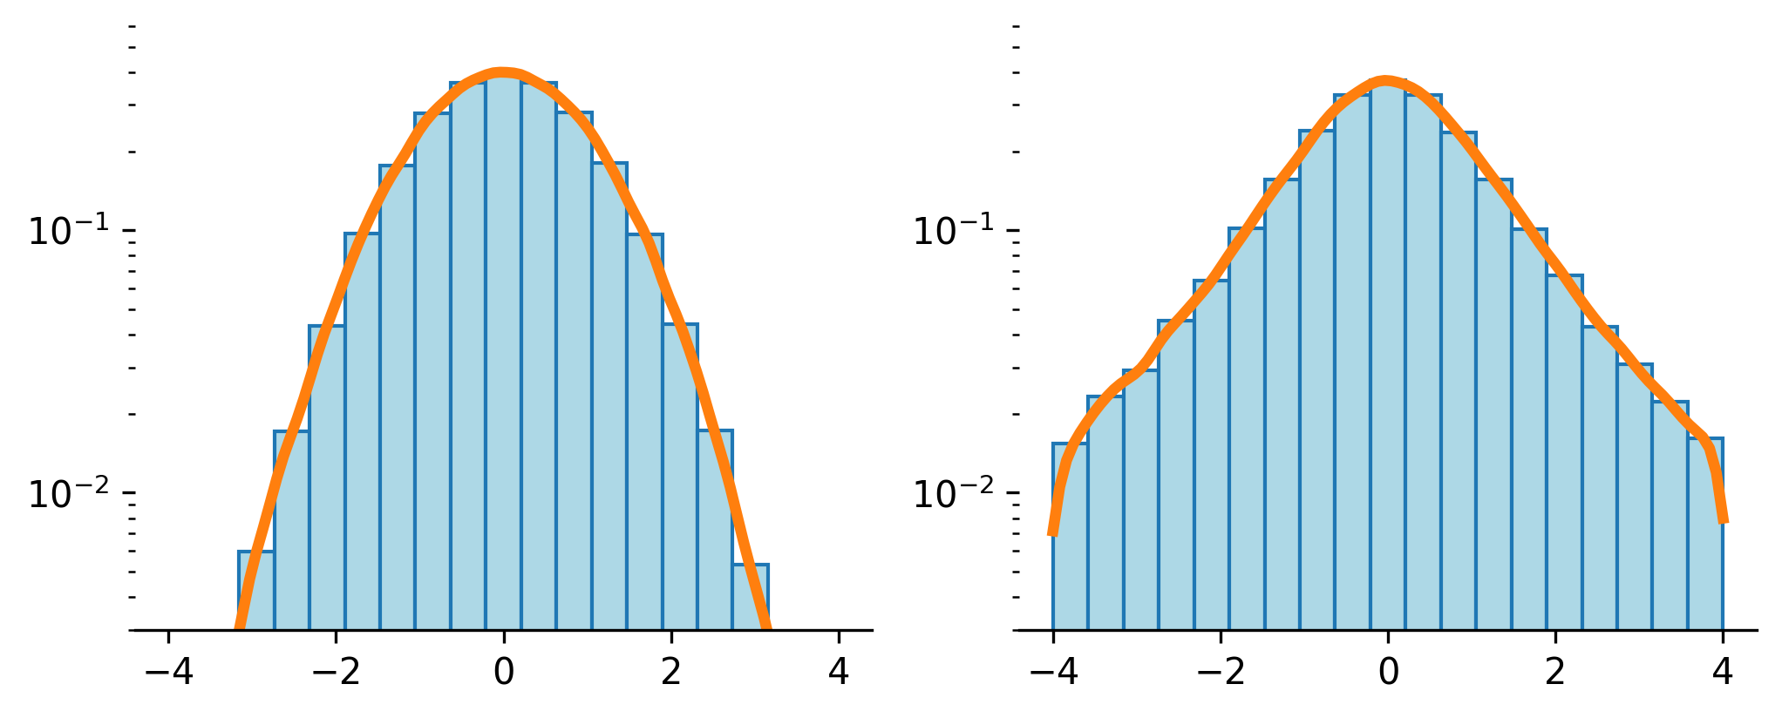
Can you spot the difference?

Slide 48
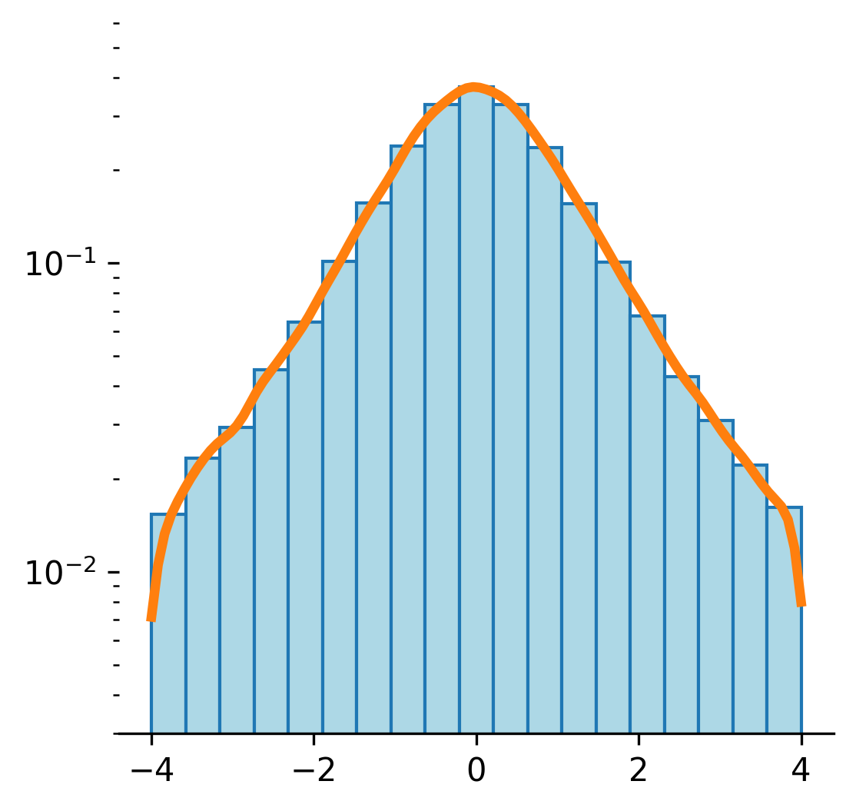
x = pd.Series(x)
x.plot.hist(density=True)
x.plot.density()
plt.yscale('log')
plt.ylim(1e-3,1)

Slide 49
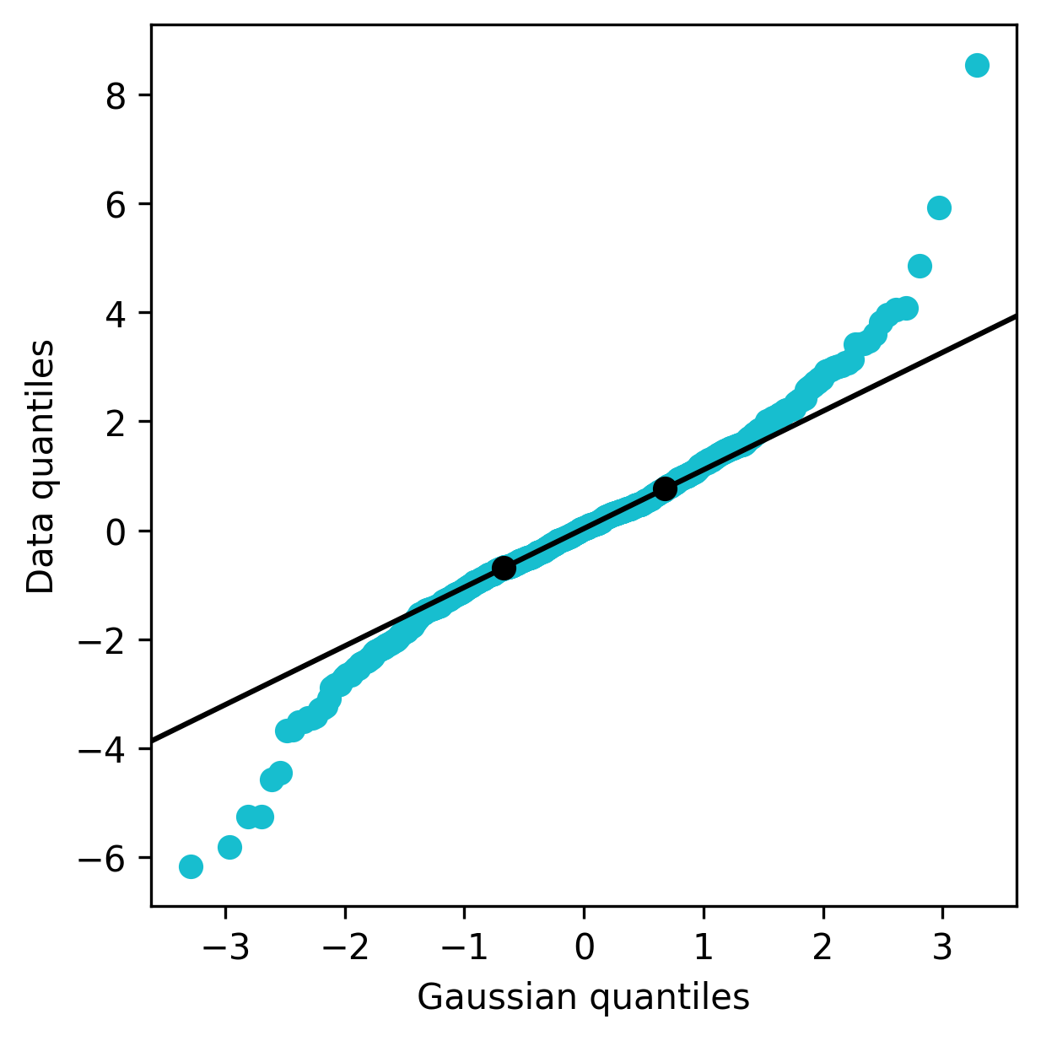
n = len(x)
D = scipy.stats.norm()
ps = np.linspace(0, 1, 2*n+1)[1::2]
ys = sorted(x)
xs = D.ppf(ps)
plt.scatter( xs, ys )

Slide 50
Exercise

Slide 51
Exercise
For each dataset:
Compute the numeric summary
Plot a boxplot, a histogram (with a linear and a logarithmic scale), a density
Which of the problems mentioned above are present?

Slide 52
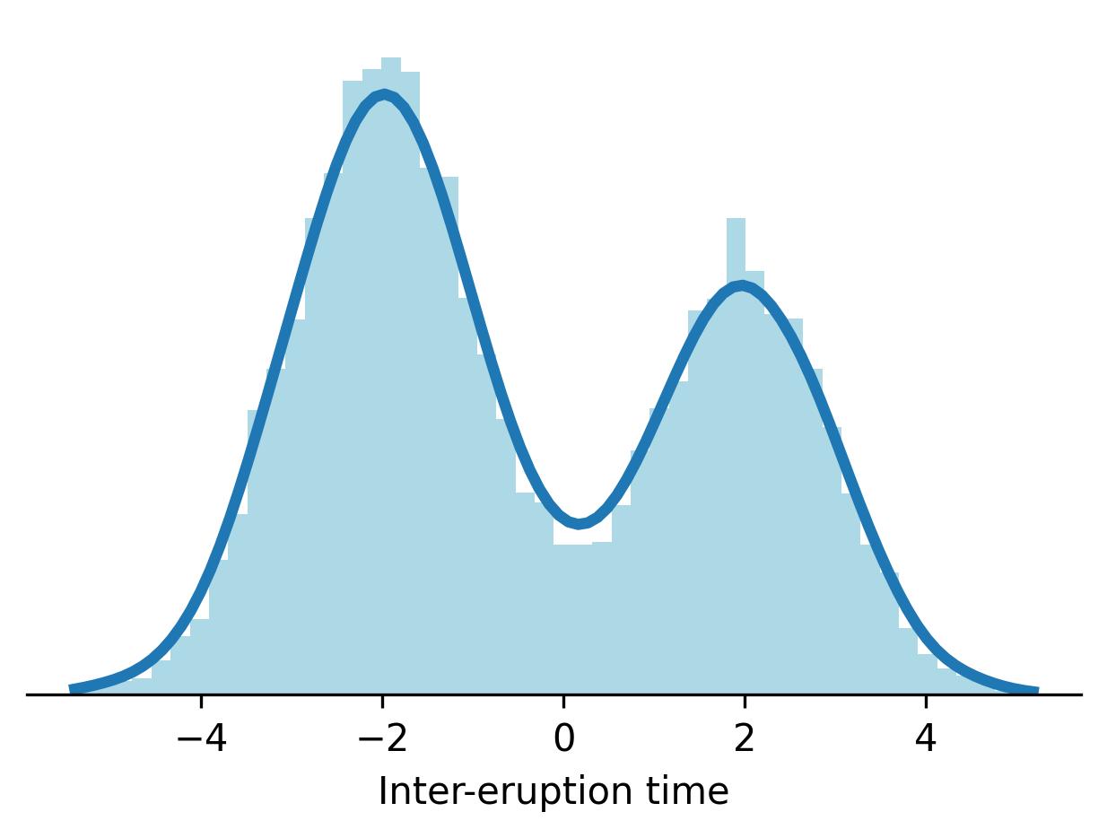

Slide 53
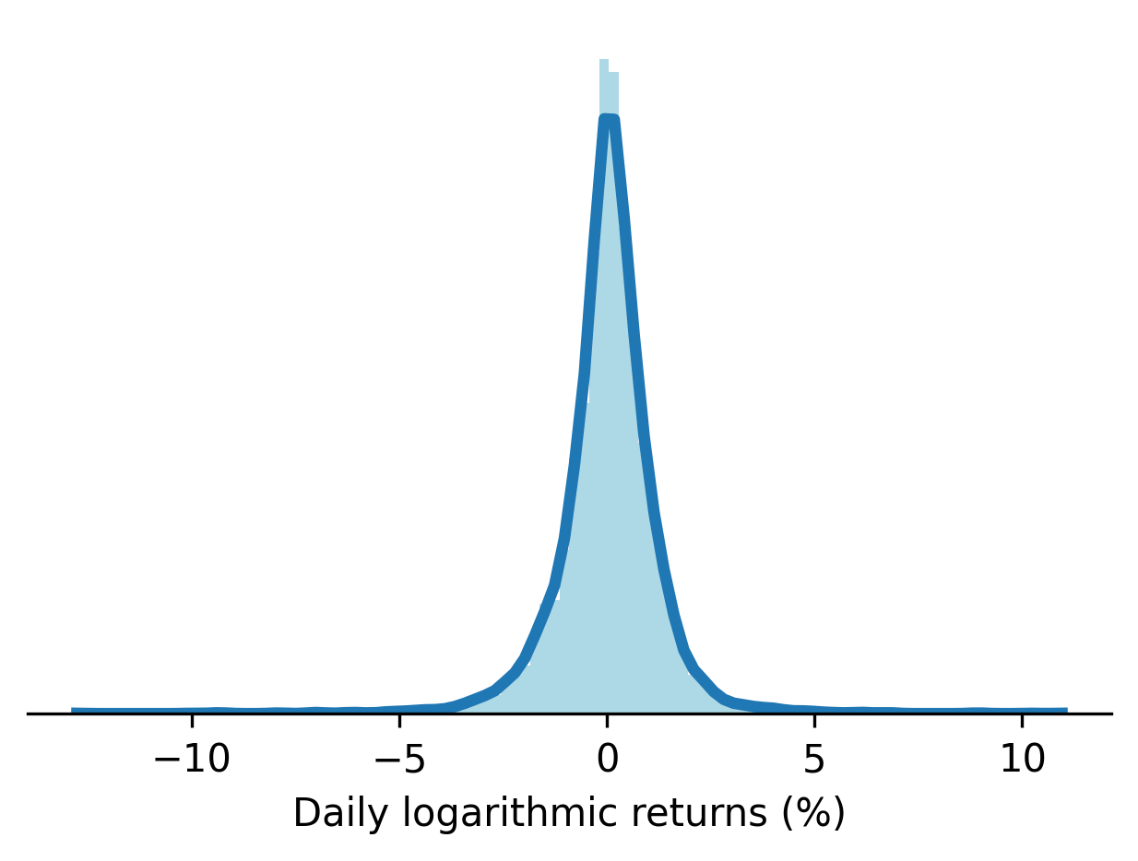

Slide 54
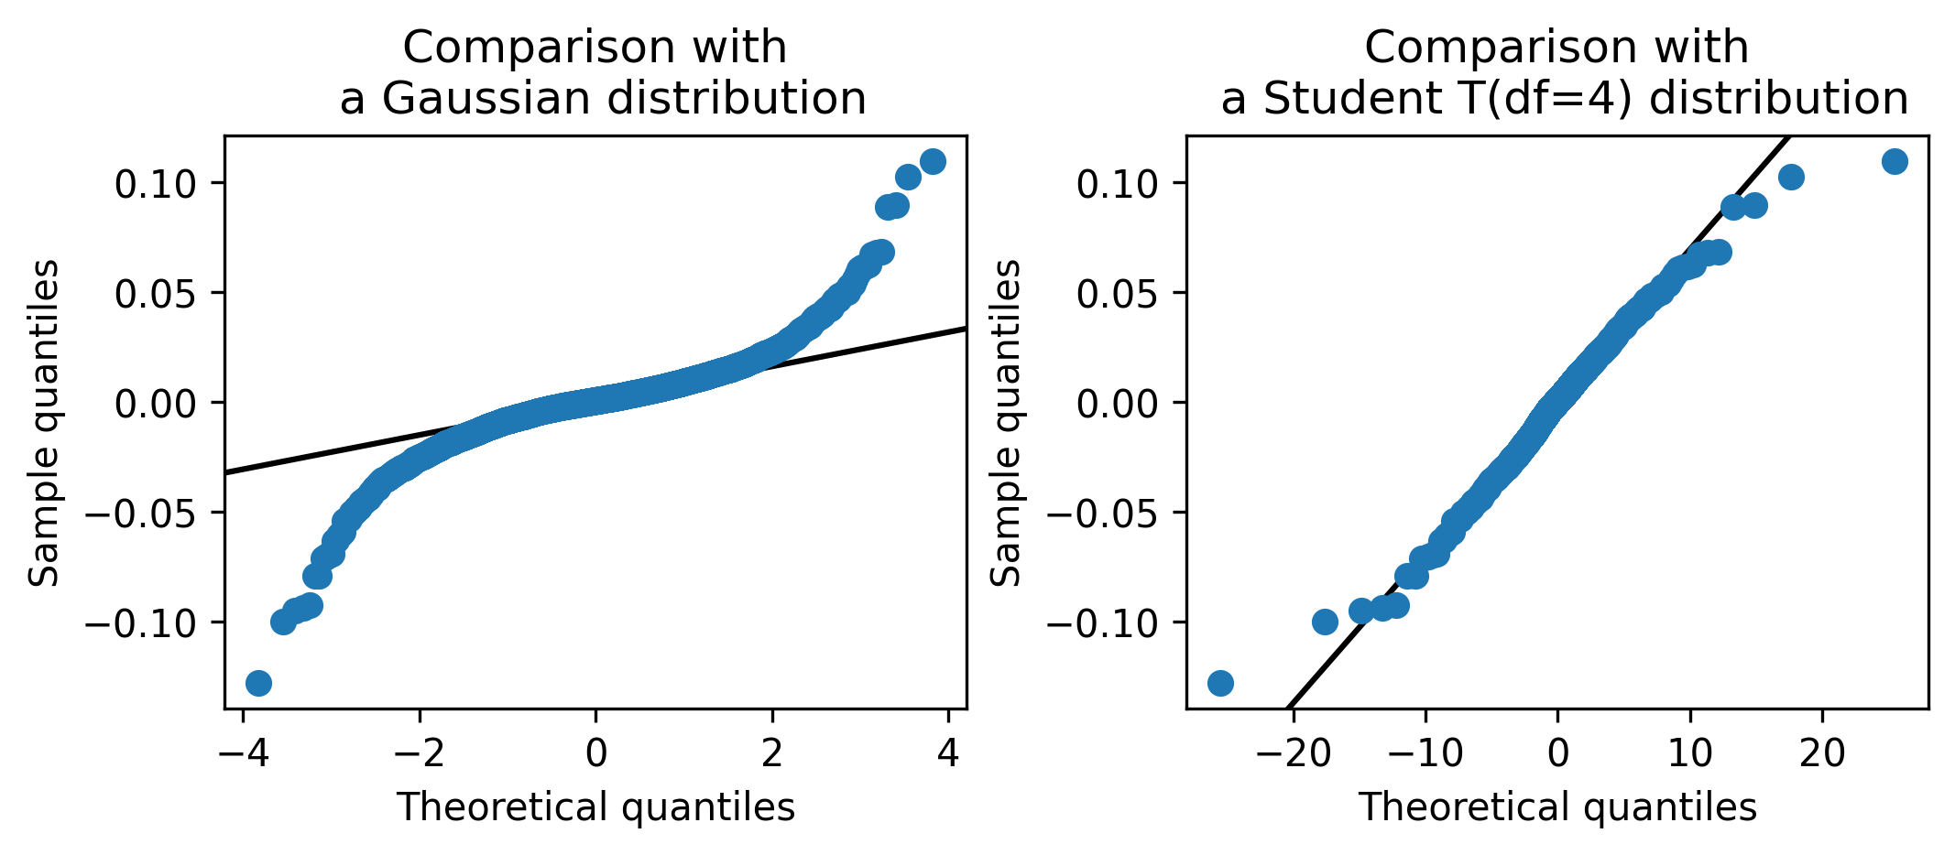

Slide 55
Bivariate Data

Slide 56
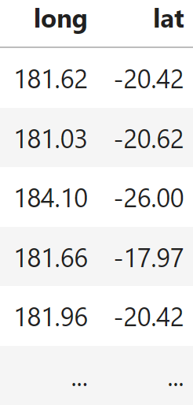
Bivariate data
Two lists of numbers; a 2-column array of numbers

Slide 57
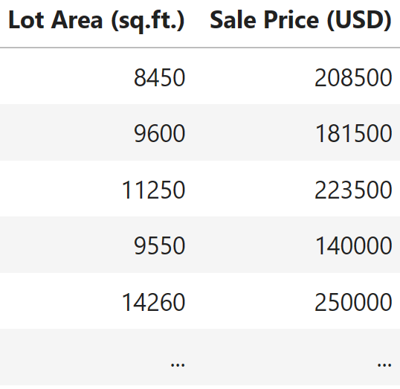
Bivariate data
Two lists of numbers; a 2-column array of numbers

Slide 58

Coordinates
(x,y)
y
x

Slide 59
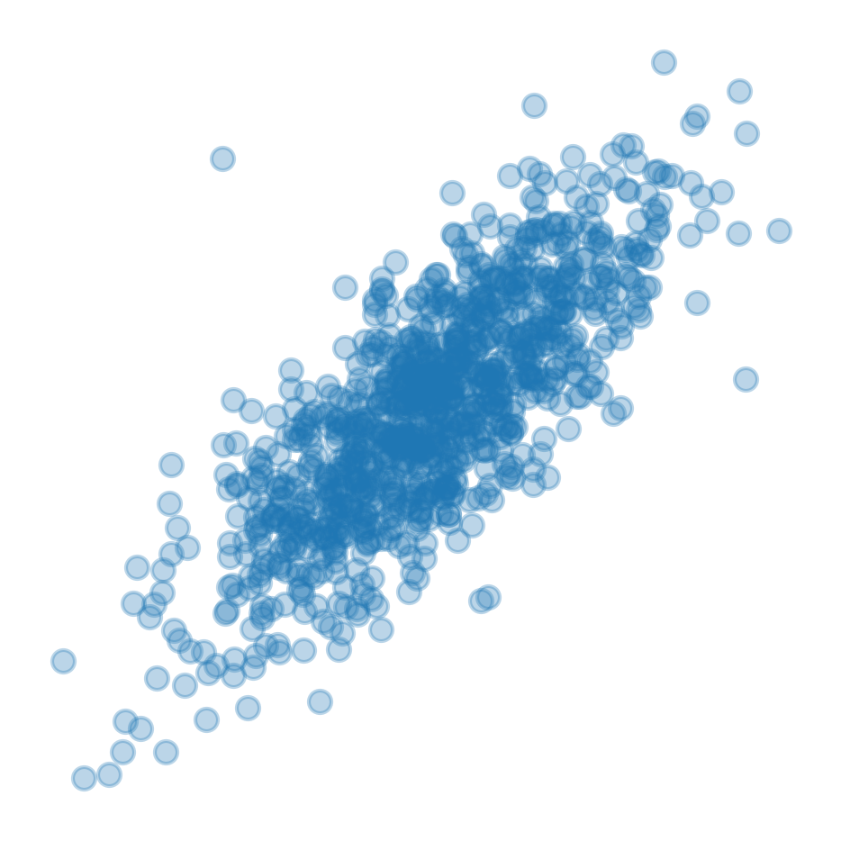

Slide 60
Potential Problems
Same as with univariate data
(Bivariate) outliers
Non-linearities
Heteroskedasticity
Missing values

Slide 62
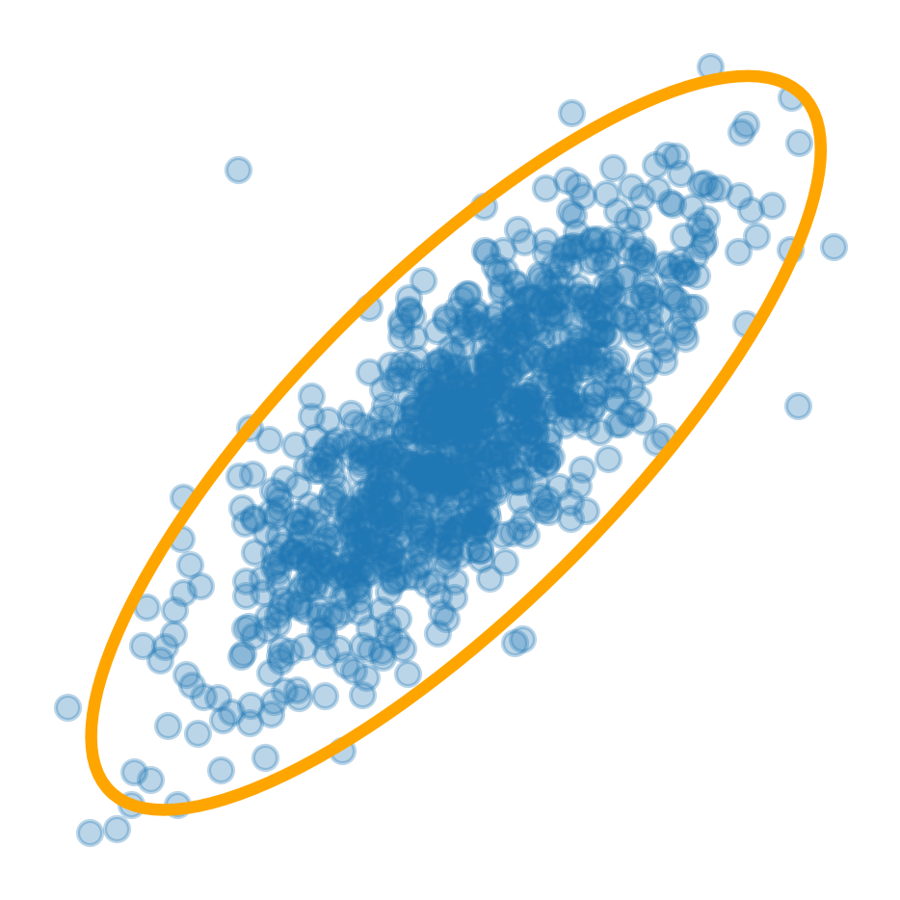

Slide 63


Slide 64
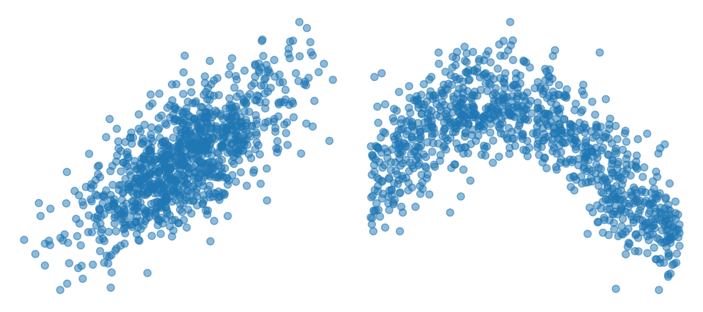
Linear Non-Linear

Slide 65
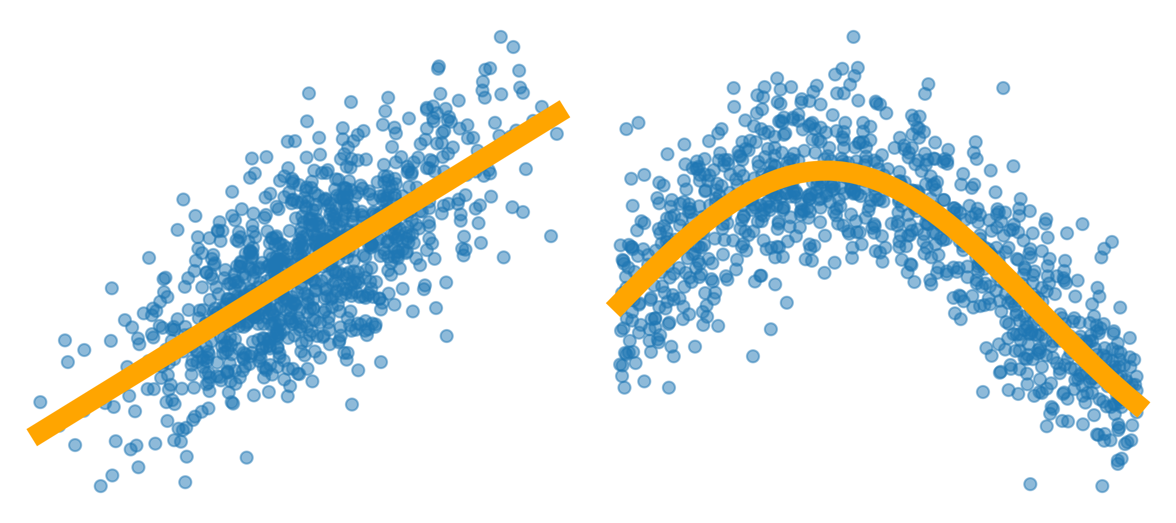
Linear Non-Linear

Slide 66
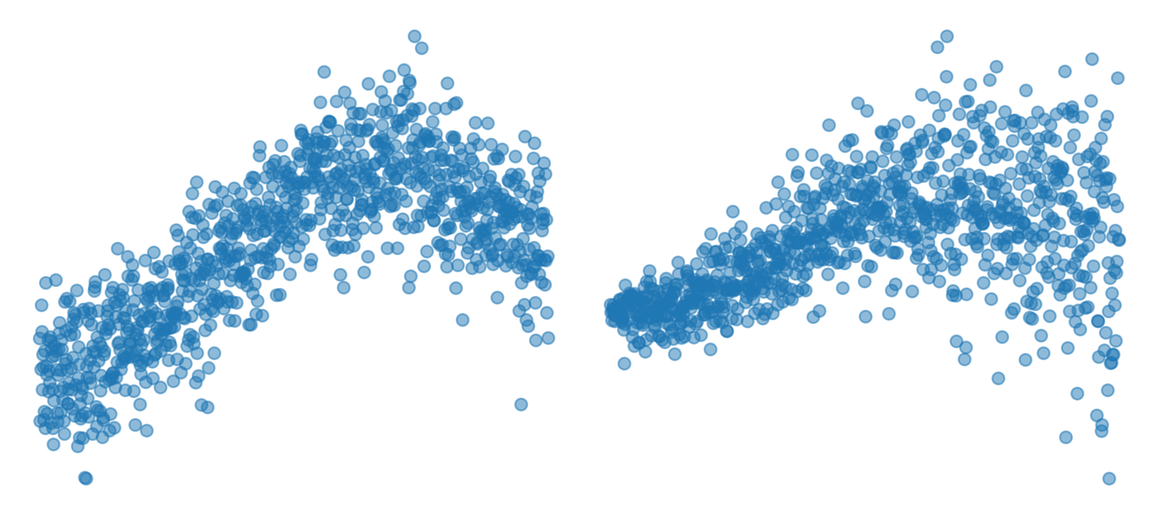

Slide 67
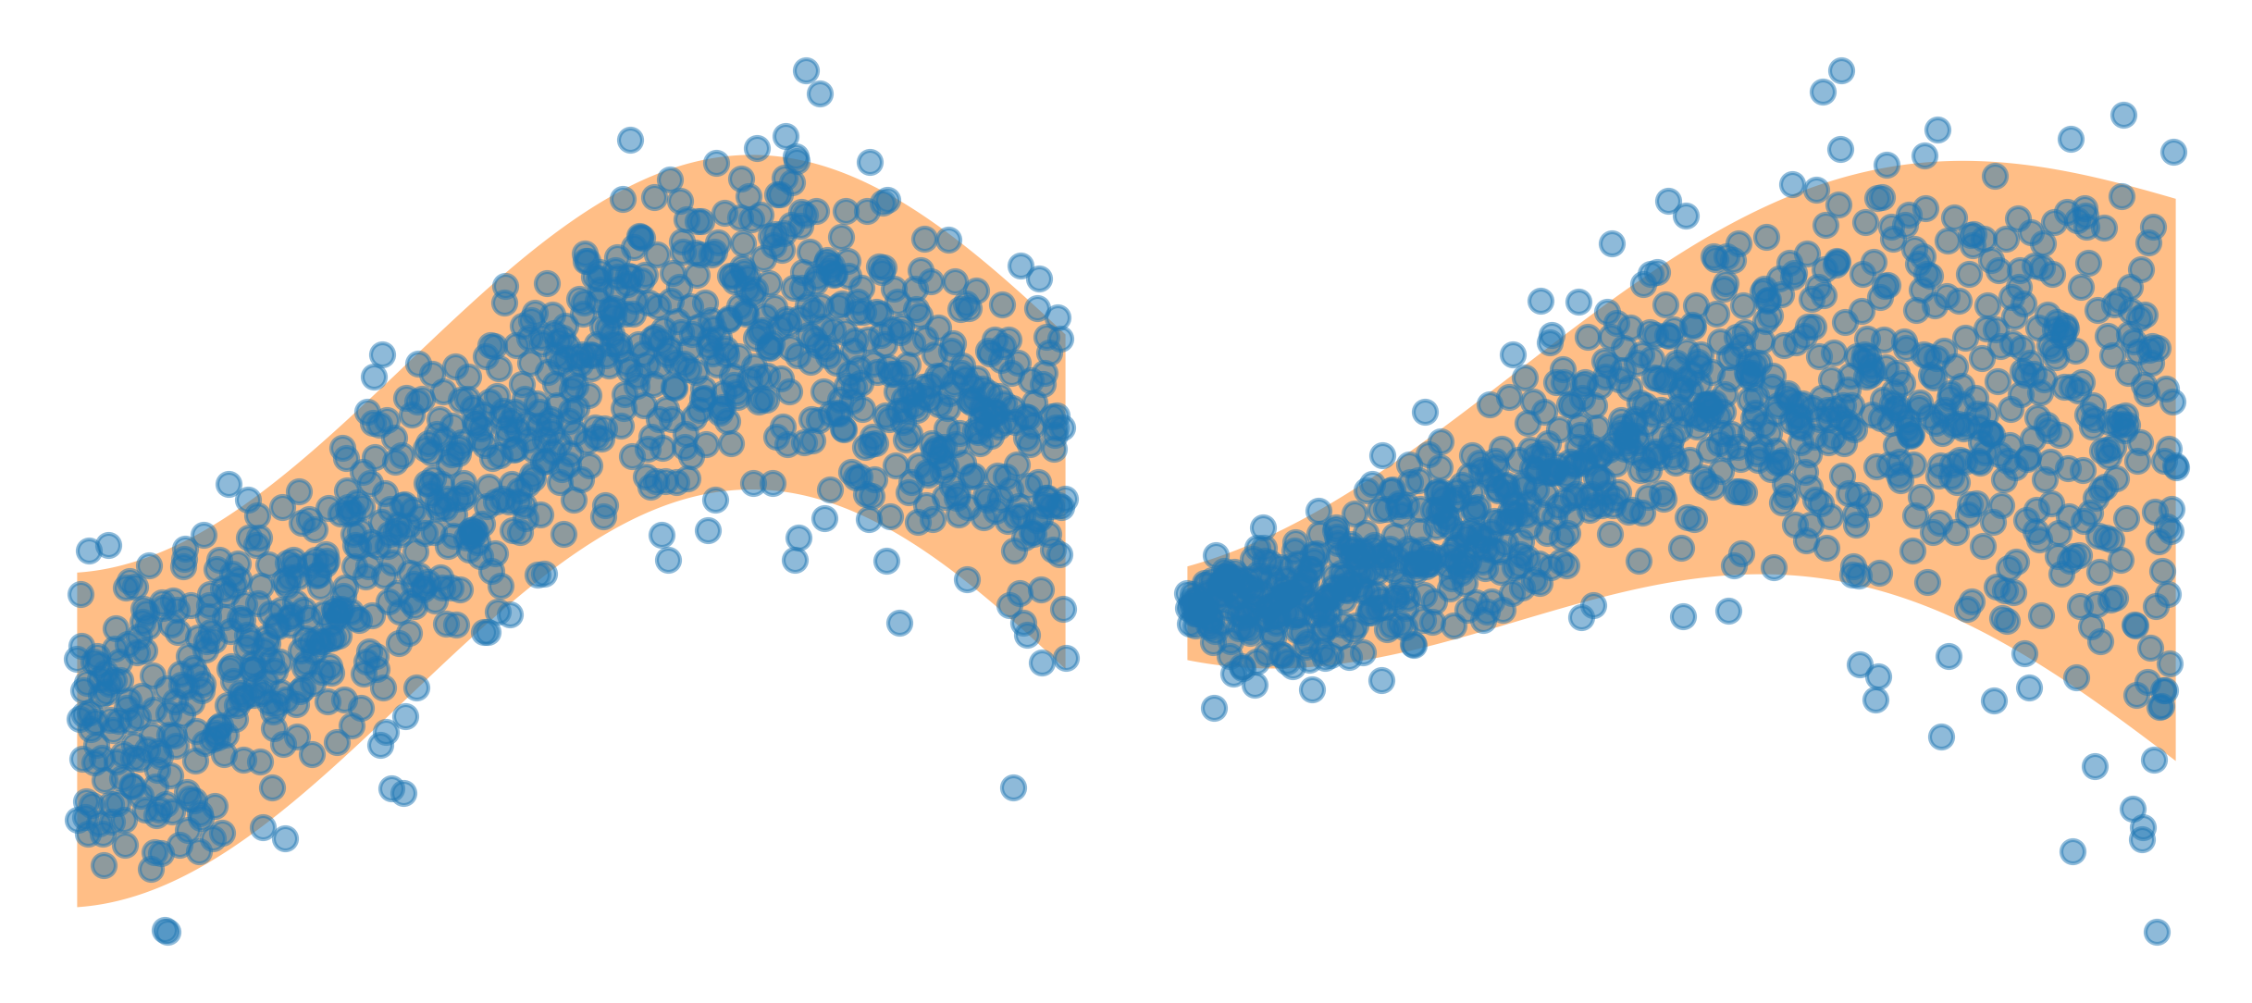

Slide 68
Numbers
Same as for univariate data
Correlation

Slide 69
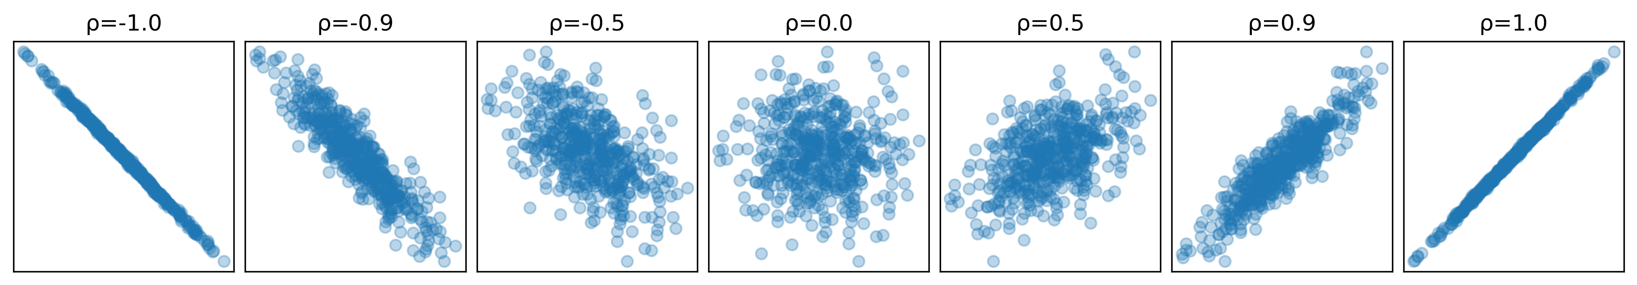
d.corr().iloc[0,1]
-0.36454403688646975

Slide 70
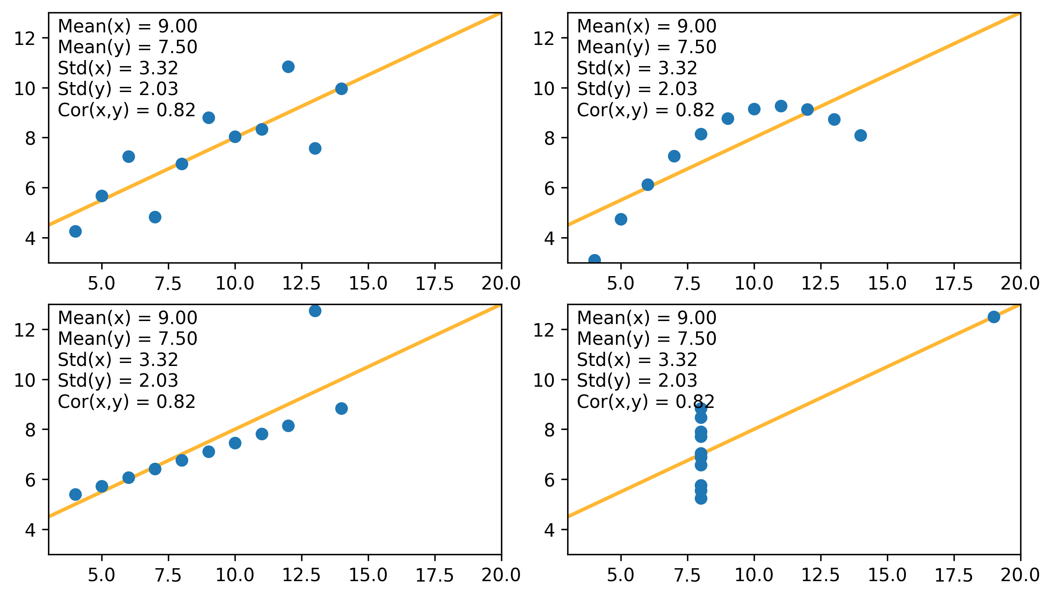

Slide 71
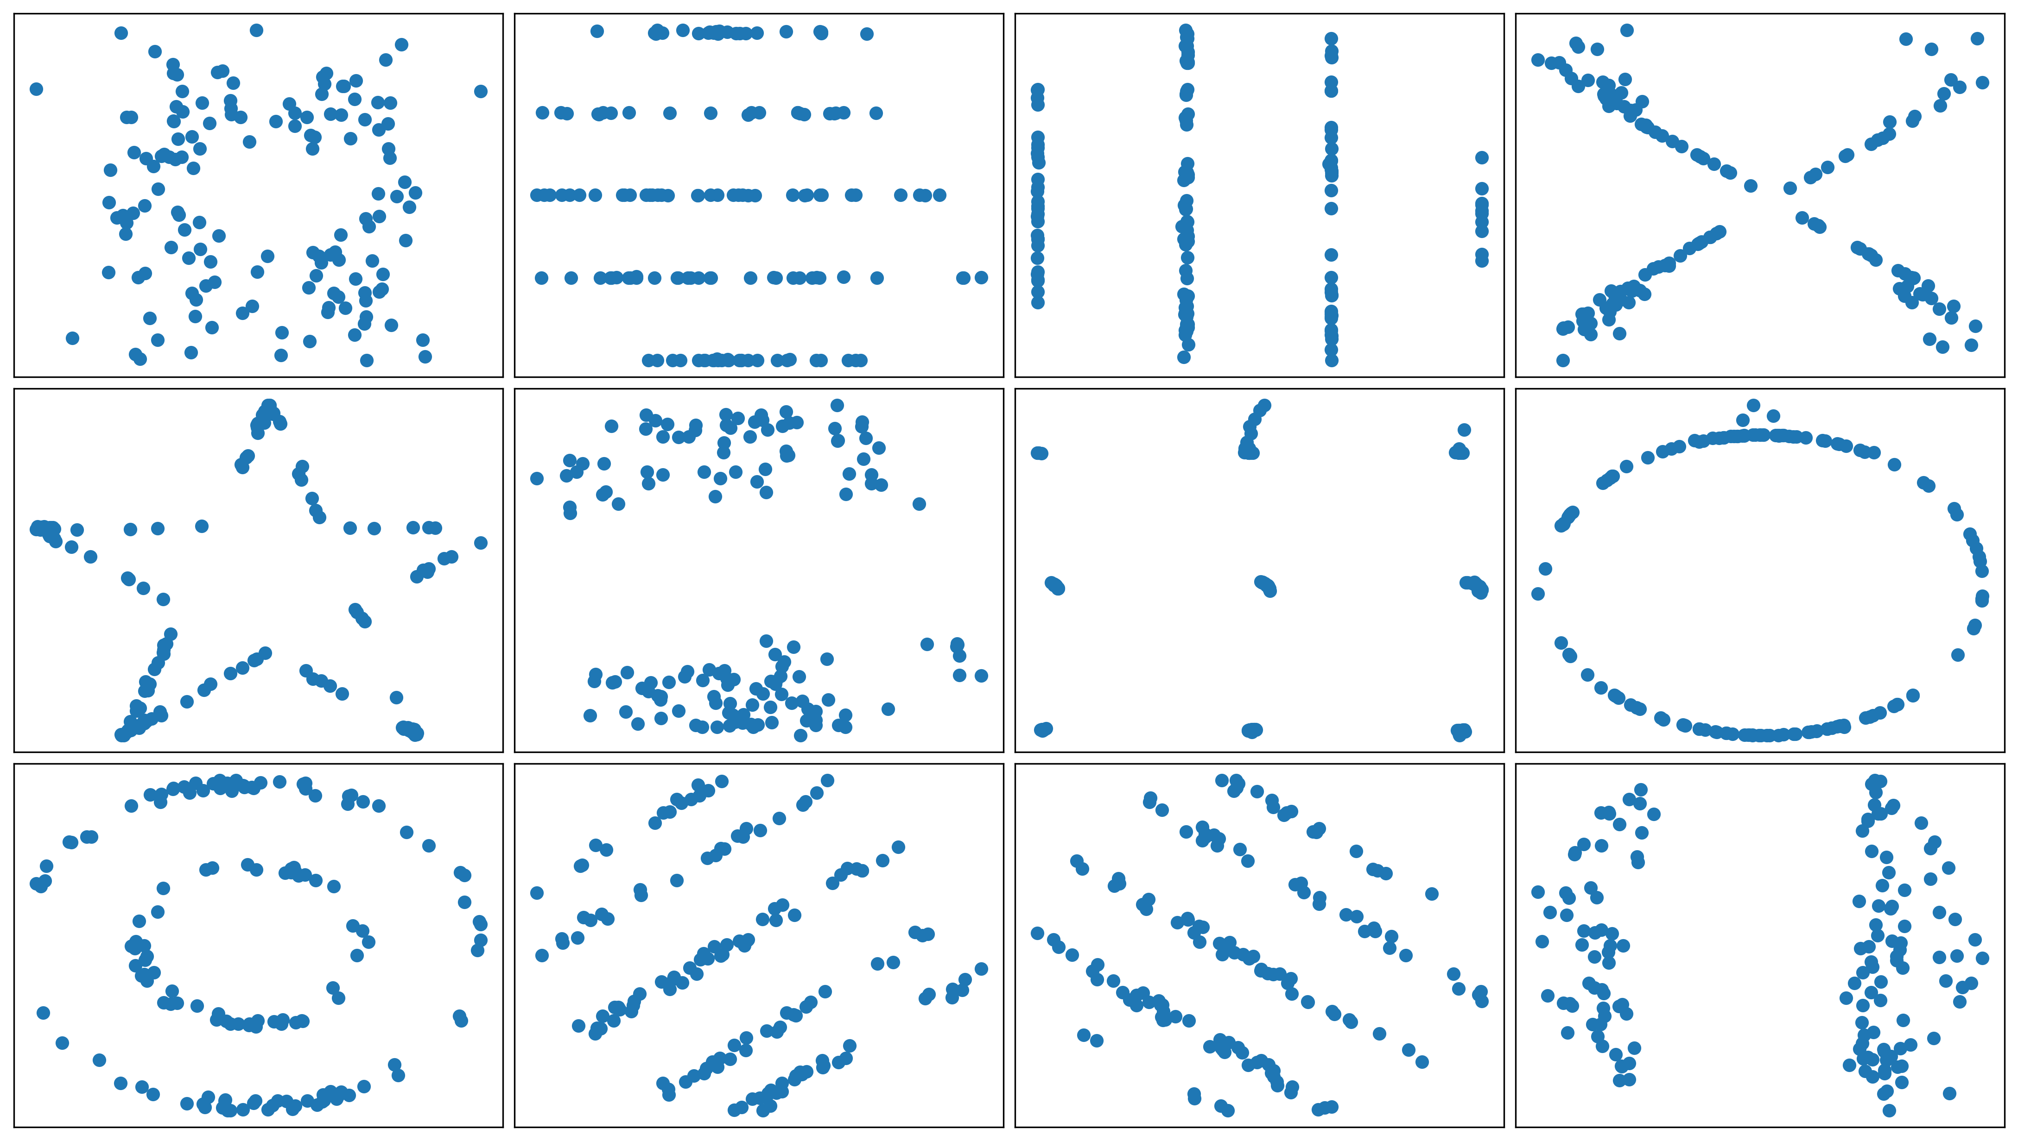

Slide 72
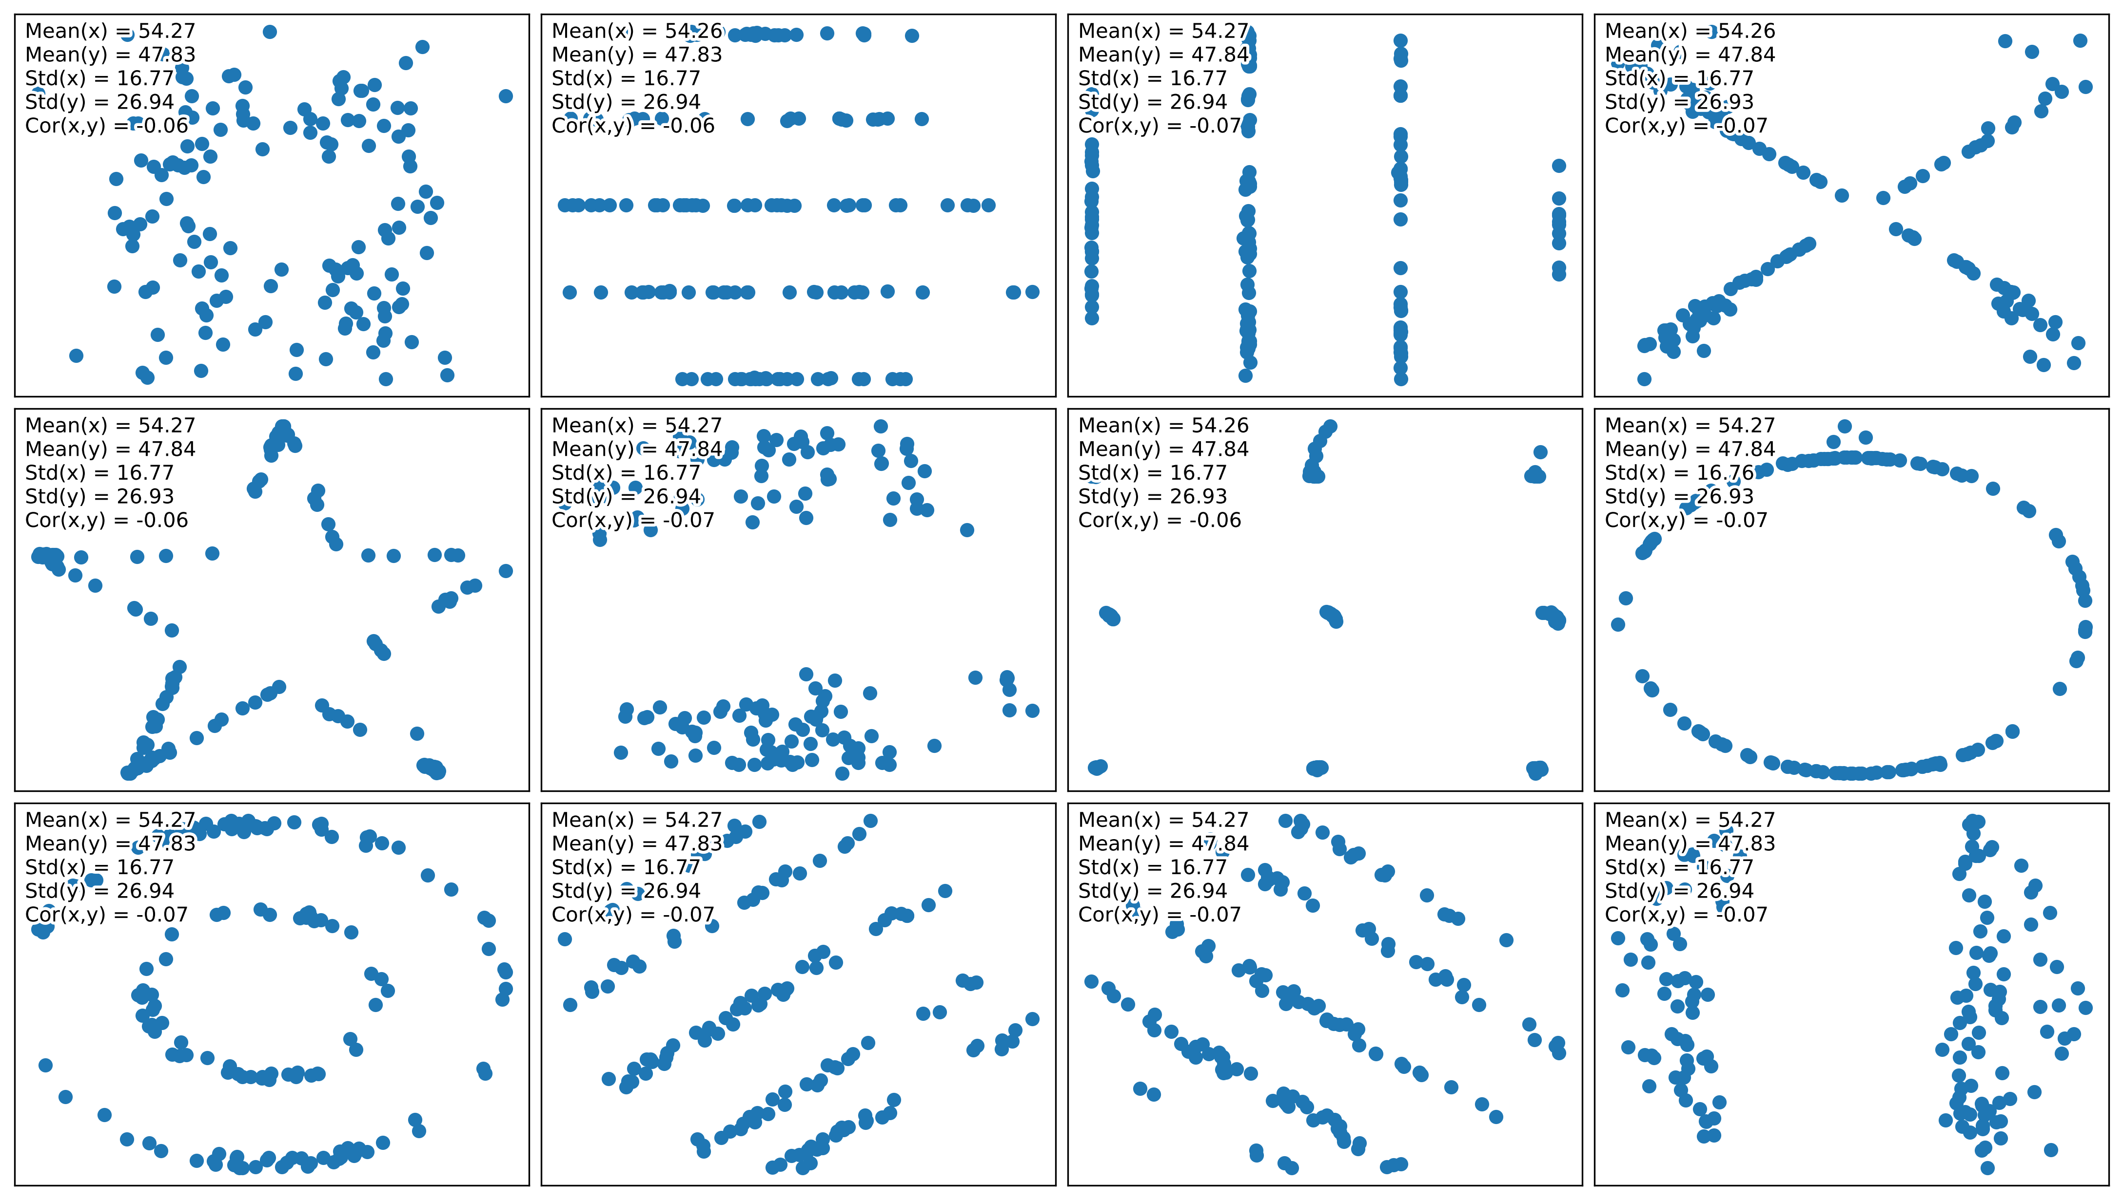

Slide 73
Plots
Scatterplot (and variants: hexbin, regression line, etc.)
Clustering (k-means, hdbscan)
Density estimation

Slide 74
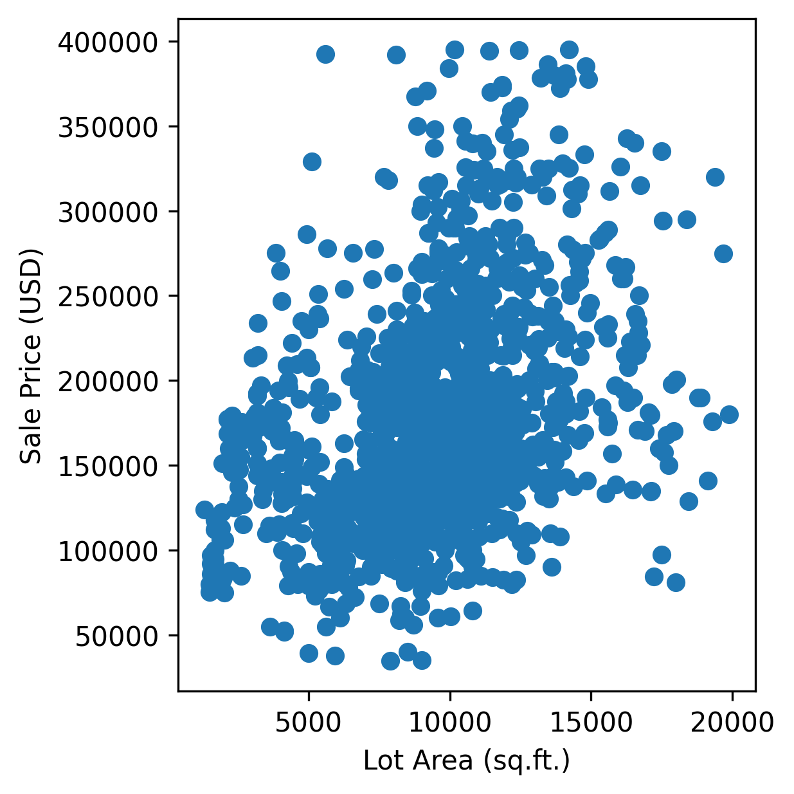
plt.scatter( x, y )

Slide 75
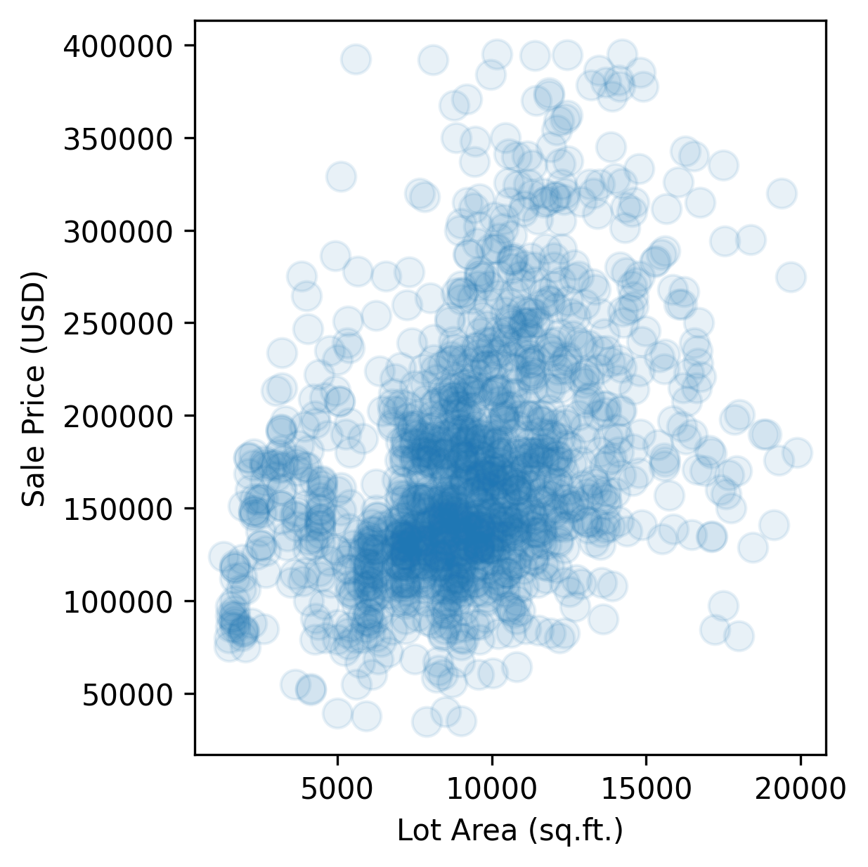
plt.scatter( x, y, alpha = .1, s = 100, )

Slide 76
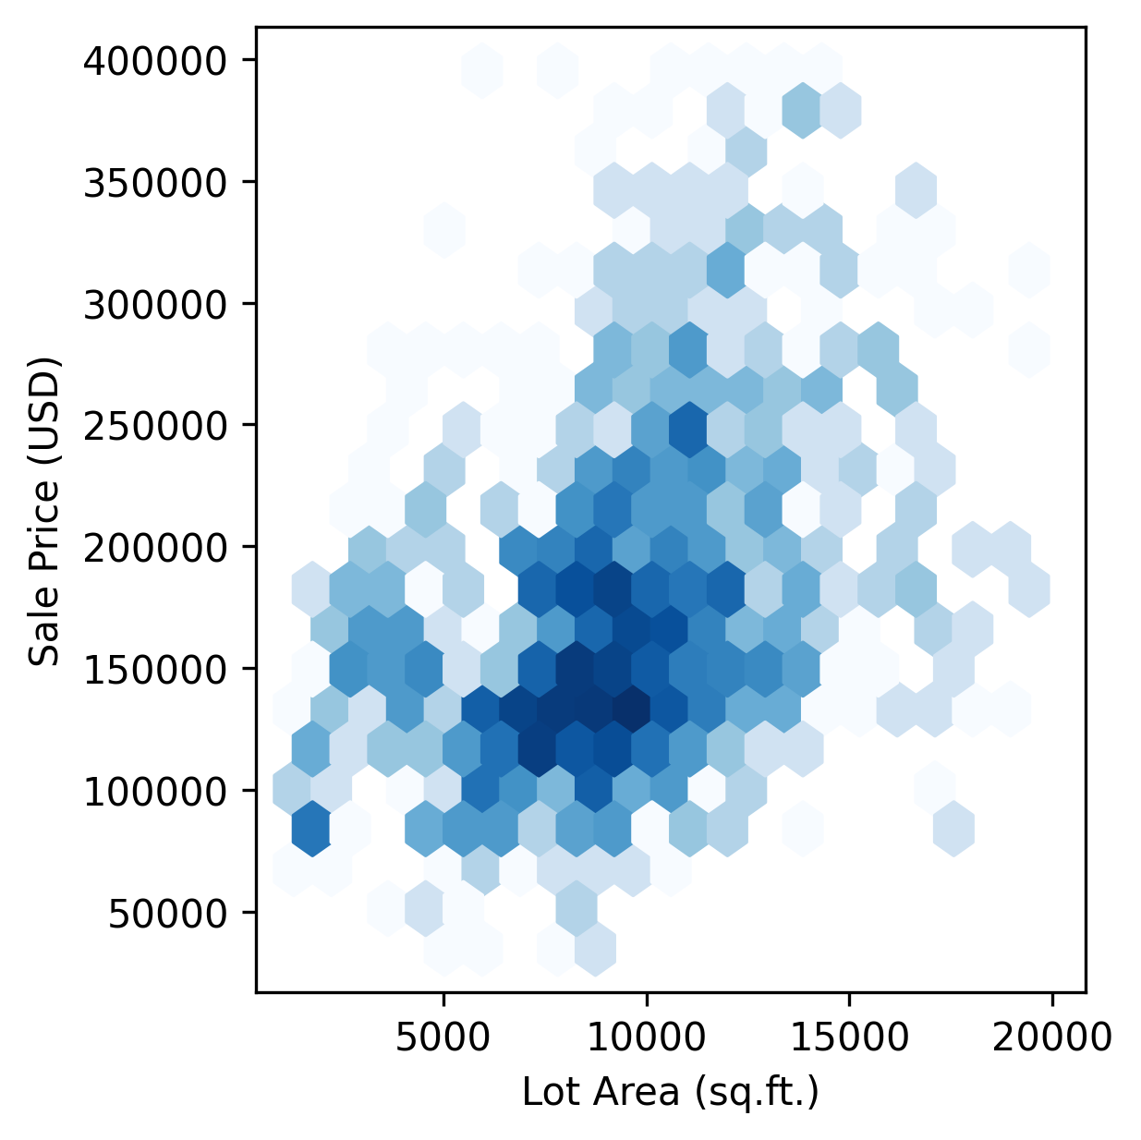
plt.hexbin( x, y, cmap = 'Blues', gridsize = 20, bins = 'log', )

Slide 77
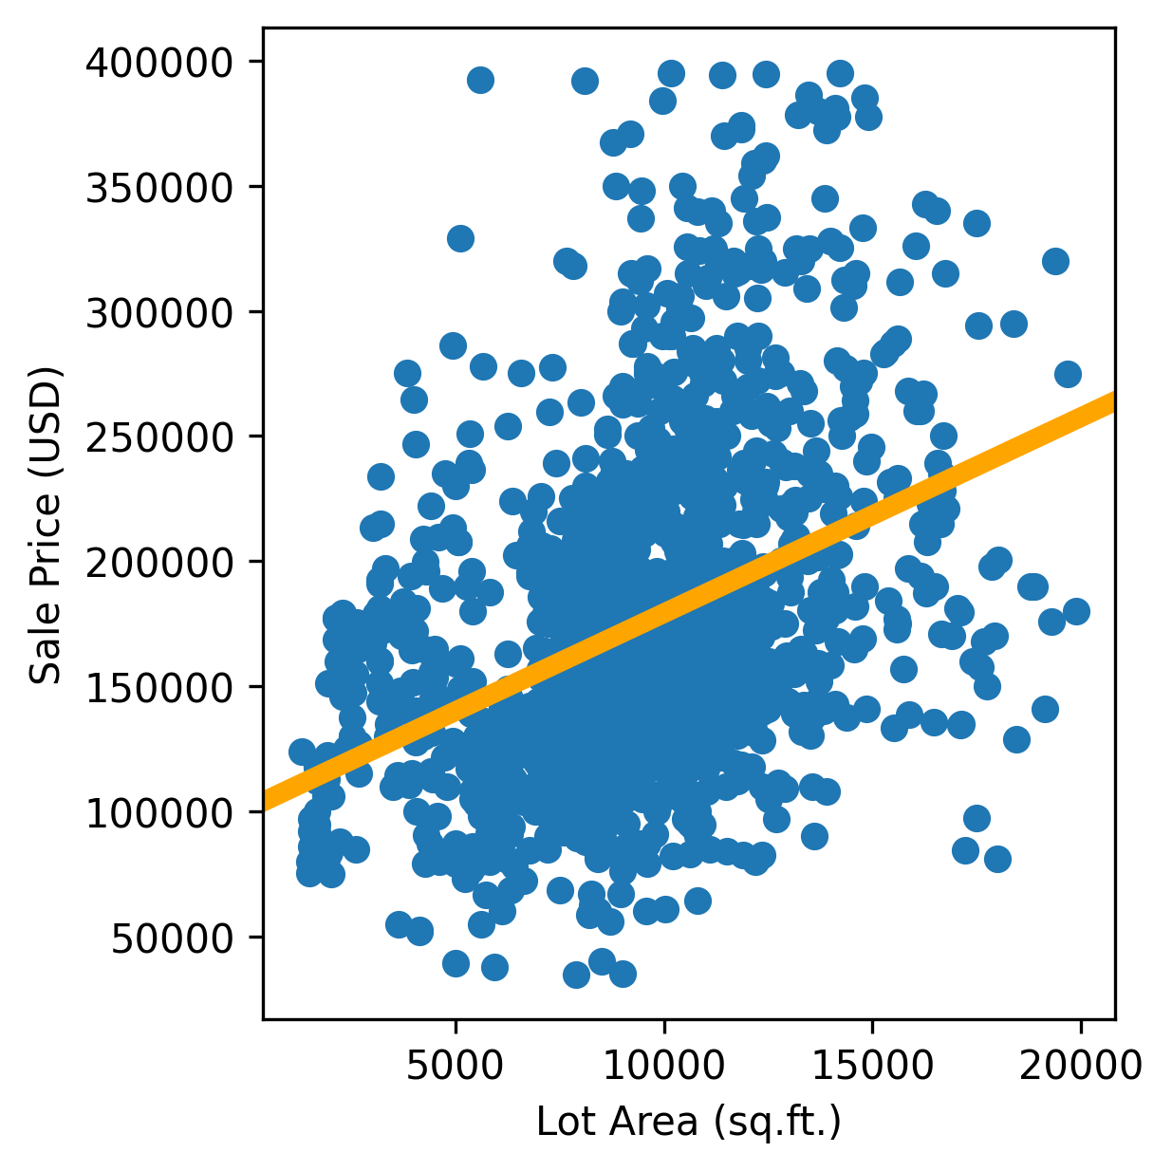
sns.regplot(x=x, y=y)

Slide 78
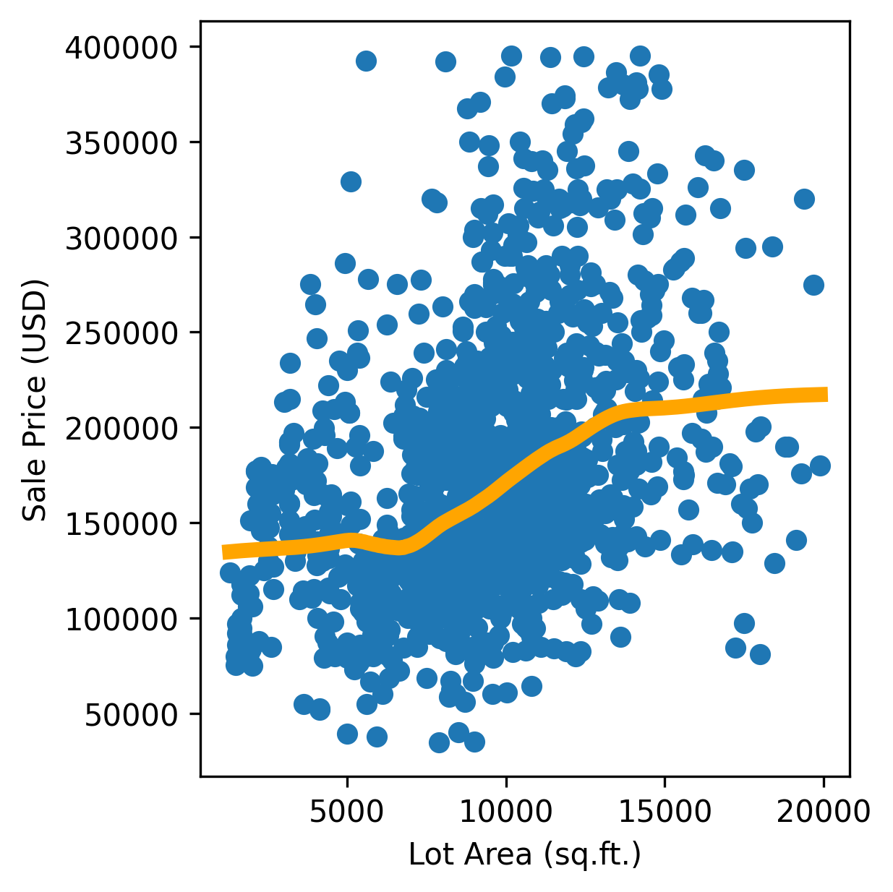
sns.regplot(x=x, y=y, lowess=True)

Slide 79


Slide 80

model = sklearn.cluster.DBSCAN()
c = model.fit_predict(d)
plt.scatter( x, y, c=c )

Slide 81

model = sklearn.cluster.DBSCAN()
c = model.fit_predict(d)
plt.scatter( x, y, c=c )

Slide 82

model = sklearn.cluster.KMeans(n_clusters=2)
c = model.fit_predict(d)
plt.scatter( x, y, c=c )

Slide 83
Exercise

Slide 84
Exercise
For each dataset:
Compute the numeric univariate and bivariate summaries
Plot (univariate) histograms and scatterplots
Are there clusters?
Which of the problems mentioned above are present?

Slide 85

plt.scatter( x, y )

Slide 86
plt.scatter( x, y, alpha = .1, s = 100, )

Slide 87

plt.hexbin( x, y, cmap = 'Blues', gridsize = 20, bins = 'log', )

Slide 88
model = sklearn.cluster.DBSCAN()
c = model.fit_predict(d)
plt.scatter( x, y, c=c )

Slide 89

model = sklearn.cluster.KMeans(n_clusters=4)
c = model.fit_predict(d)
plt.scatter( x, y, c=c )

Slide 90
Qualitative Data

Slide 91
Qualitative/Categorical Data
List of strings, e.g., ['SI2', 'SI1', 'VS1', ..., 'SI1', 'SI2', 'SI2']

Slide 92
Potential Problems
Unbalanced data
Many values
Long tail
Missing values

Slide 93
Numbers
Number of observations
Number of missing values
Number of different values
Mode

Slide 94
Numbers
{
'observations': len(x),
'missing': x.isnull().sum(),
'Unique values': len(np.unique(x.values)),
'Mode': Counter(x).most_common(1)[0][0],
'Mode count': Counter(x).most_common(1)[0][1],
}

Slide 95
Plots
Barplot
Barplot on a log-log scale, if there are many values

Slide 96

c = Counter(x)
c = pd.DataFrame( { 'clarity': c.keys(), 'count': c.values(), } ).sort_values('count' )
plt.barh( c['clarity'], c['count'] )

Slide 97

c = Counter(x)
c = pd.DataFrame( { 'word': c.keys(), 'count': c.values(), } ).sort_values( 'count', ascending = False, )
plt.scatter( 1+np.arange(c.shape[0]), c['count’], )
plt.xscale('log’)
plt.yscale('log')

Slide 98


Slide 99
Exercise

Slide 100
Multivariate Data

Slide 101

Multivariate Data
A table of numbers, with one “variable” per column.

Slide 102
Potential Problems
Same as before
Different scales or units

Slide 103
Numbers
Univariate and bivariate summaries

Slide 104
d.describe()
cost q pl sl pk
count 158.000000 158.000000 158.000000 158.000000 158.000000
mean 53.269962 10469.410759 8001.863228 0.138972 71.421063
std 87.059326 15187.520802 1398.837478 0.054735 11.977489
min 0.130400 4.000000 5063.490000 0.045900 31.725000
25% 10.221050 1971.000000 6975.177500 0.099725 67.605000
50% 25.545400 5645.500000 7890.185000 0.123100 74.120000
75% 55.315900 12365.750000 8855.230000 0.169800 78.794250
max 737.408800 115500.000000 13044.000000 0.329100 92.650000

Slide 105
Plots
Boxplot
Pairs plots
Correlation matrix
Dimension reduction: PCA, UMAP
Clustering: k-means, DBScan

Slide 106

plt.boxplot(d, vert=False)

Slide 107

plt.boxplot(d / d.std(), vert=False)

Slide 108


Slide 109

plt.violinplot(d / d.std(), vert=False)

Slide 110


Slide 111


Slide 112


Slide 113


Slide 114

sns.pairplot(d)

Slide 115

k = d.shape[1]
fig, axs = plt.subplots(
k, k,
figsize = (16,9),
layout = 'constrained’,
)
for i, id1 in enumerate( d.columns ):
for j, id2 in enumerate( d.columns ):
ax = axs[i,j]
if i == j:
ax.hist( d[id1], bins = 20, density = True )
ax.text(.5, .99, id1,
ha = 'center', va = 'top’,
transform = ax.transAxes)
for side in ['left', 'right', 'top']:
ax.spines[side].set_visible(False)
ax.set_yticks([])
if i != j:
ax.scatter( d[id2], d[id1], alpha = .3 )
ax.text(
.5, .99,
f"{np.corrcoef( d[id1], d[id2] )[0,1]:.2f}",
ha = 'center', va = 'top’,
transform = ax.transAxes,
)
ys = statsmodels.nonparametric.smoothers_lowess.lowess(
d[id1], d[id2],
frac = .5,
)
ax.plot(
ys[:,0], ys[:,1],
color = 'orange', linewidth = 3,
)
ax.axis('off')
plt.show()

Slide 116
sns.clustermap( d.corr(), vmin = -1, vmax = +1, cmap = 'RdBu', figsize = (5, 5), annot = True, fmt = ".2f", )

Slide 117

X = sklearn.decomposition.PCA(2). fit_transform(dd)
plt.scatter( X[:,0], X[:,1] )

Slide 118

X = sklearn.decomposition.PCA(2). fit_transform(d)
plt.scatter( X[:,0], X[:,1], c = d[column], )

Slide 119


Slide 120


Slide 121


Slide 122


Slide 123


Slide 124

X = sklearn.decomposition.PCA(2). fit_transform(d)
fig, axs = plt.subplots( 3, 3 )
for i, column in enumerate(d.columns):
ax = axs.flatten()[i]
ax.scatter( X[:,0], X[:,1], c = d[column], )
ax.axis('off')
ax.set_title(column)
plt.show()

Slide 125
X = sklearn.decomposition.PCA(2). fit_transform(d)
fig, axs = plt.subplots( 3, 3 )
for i, column in enumerate(d.columns):
ax = axs.flatten()[i]
ax.scatter( X[:,0], X[:,1], c = d[column], )
ax.axis('off')
ax.set_title(column)
plt.show()

Slide 126

X = UMAP().fit_transform(d)
plt.scatter( X[:,0], X[:,1] )

Slide 127

X = UMAP().fit_transform(d)
fig, axs = plt.subplots( 3, 3 )
for i, column in enumerate(d.columns):
ax = axs.flatten()[i]
ax.scatter( X[:,0], X[:,1], c = d[column], )
ax.axis('off')
ax.set_title(column)
plt.show()

Slide 128
X = UMAP().fit_transform(d)
fig, axs = plt.subplots( 3, 3 )
for i, column in enumerate(d.columns):
ax = axs.flatten()[i]
ax.scatter( X[:,0], X[:,1], c = d[column], )
ax.axis('off')
ax.set_title(column)
plt.show()

Slide 129
X = UMAP().fit_transform(d)
model = sklearn.cluster.DBSCAN()
c = model.fit(X).labels_
plt.scatter( X[:,0], X[:,1], c=c )

Slide 130
Time Series

Slide 131


Time Series
Bivariate data, where one of the variables is time.

Slide 132
Problems
Same as for univariate data
Suspicious values: repetitions, anomalies, jumps
Non-stationarity
Irregular sampling

Slide 133


Slide 134


Slide 135


Slide 136


Slide 137


Slide 138


Slide 139


Slide 140


Slide 141


Slide 142


Slide 143


Slide 144


Slide 145


Slide 146


Slide 147


Slide 148
Numbers
Same as for univariate data

Slide 149

Numbers
Same as for univariate data
Auto-correlation: Cor(xₜ,xₜ₊ₖ)

Slide 150

x_{t+1}
x_{t}

Slide 151

x_{t+1}
x_{t}

Slide 152
Plots
Time series
Auto-correlation

Slide 153


Slide 154


Slide 155


Slide 156
Exercise

Slide 157
Exercise
Plot the following time series
Are there data issues?
Are there seasonal patterns? With which period?

Slide 158



Slide 159
Afternoon Session

Slide 160
Multivariate with qualitative data

Slide 161
Exercise

Slide 162






Slide 163


Slide 164


Slide 165


Slide 166


Slide 167


Slide 168


Slide 169
Exercise

Slide 170


Slide 171


Slide 172


Slide 173


Slide 174


Slide 175


Slide 176


Slide 177


Slide 178


Slide 179


Slide 180
Automated EDA

Slide 181
Automated EDA
from ydata_profiling import ProfileReport
ProfileReport(d)
There are libraries to do most of this automatically.

Slide 182
Exercise
Examine one of the datasets above with ydata_profiling.
Is there anything we have overlooked?

Slide 183
Summary

Slide 184
Potential Problems
Data types
Missing values
Magic numbers
Zero inflation
Outliers
Fat tails
Skewness
Multimodality
Bivariate outliers
Non-linearity
Heteroskedasticity
Different units
Long tail
Non-stationarity

Slide 185
Numbers
Mean, median, mode
Standard deviation
Quantiles, IQR
Skewness
Kurtosis
Missing values
Correlation

Slide 186
Plots
Histogram, density (+log scale)
Scatterplot (+curve fitting, clustering)
Clustering: k-means, DBScan
Pairplot
Boxplots
Correlation matrix (+hierarchical clustering)
Dimension reduction: PCA, UMAP (+clustering)

Slide 187
Plots

Slide 188
Plots
Scatterplot (with transparency)
Fitted line
Clustering (k-means, DBScan)
Histogram
Correlation matrix
Dimension reduction (PCA, UMAP)
Log scale
Boxplot
Pair plot

Slide 189
Plots
Histogram
Scatterplot (with transparency)
Fitted line
Clustering (k-means, DBScan)
Correlation matrix
x.plot.hist(density=True)
x.plot.density(linewidth=5)
plt.scatter( x, y, alpha = .1, s = 100, )
x = d.iloc[:,0]
y = d.iloc[:,1]
sns.regplot(
x=x,y=y,
lowess=True,
scatter_kws={'alpha': .2},
line_kws={'color': 'orange'},
)
model = sklearn.cluster.KMeans(n_clusters=4)
model = sklearn.cluster.DBSCAN()
c = model.fit_predict(d)
plt.scatter( x, y, c=c )
sns.clustermap( d.corr(), vmin = -1, vmax = +1, cmap = 'RdBu’, figsize = (5, 5), annot = True, fmt = ".2f", )
Log scale
Boxplot
Pair plot
Dimension reduction (PCA, UMAP)
x.plot.hist(density=True)
x.plot.density()
plt.yscale('log')
plt.ylim(1e-3,1)
plt.boxplot(d/d.std(), vert=False)
sns.pairplot(d)
X = UMAP().fit_transform(d)
plt.scatter( X[:,0], X[:,1] )

Slide 190
References

Slide 191
References
Learn X in Y minutes, where X=Python https://learnxinyminutes.com/docs/python/
Statistical plots V. Zoonekynd (2020) https://www.youtube.com/watch?v=YrSjtxGGhX0
Modern Data Visualization with R R. Kabacoff https://rkabacoff.github.io/datavis/Advice.html
An introduction to statistical learning G. James et al. (2013, 2023) https://www.statlearning.com/
Scientific visualization, Python & Matplotlib N.P. Rougier (2021) https://github.com/rougier/scientific-visualization-book
Matplotlib, Pandas, NumPy cheat sheets https://matplotlib.org/cheatsheets/ https://pandas.pydata.org/Pandas_Cheat_Sheet.pdf https://www.datacamp.com/cheat-sheet/pandas-cheat-sheet-for-data-science-in-python https://www.datacamp.com/cheat-sheet/numpy-cheat-sheet-data-analysis-in-python

Slide 192
Extra Slides

Slide 193


Slide 194


Slide 195
Plotting Advice

Slide 196
Plotting advice
Label the axes
Line plots instead of Excel plots
Horizontal labels
Unambiguous date format
Years are intervals, not points
Discrete gradients
Logarithmic scales
Thick lines; even thicker lines in the legend
Same order in the legend and in the plot
Labels on the plot instead of in the legend
Colour palettes
Darker, more saturated colours for line plots

Slide 197
Label the axes

Slide 198

Line Plots

Slide 199

Horizontal Labels

Slide 200

Logarithmic scales

Slide 201

Logarithmic scales

Slide 202

Logarithmic scales

Slide 203
Unambiguous date format

Slide 204

Years are intervals

Slide 205

Years are intervals

Slide 206

Discrete gradients

Slide 207

Discrete gradients

Slide 208

Thick lines

Slide 209

Thicker lines in the legend

Slide 210
Labels on the plot

Slide 211

Legend order

Slide 212


Colour palettes

Slide 213
Colour palettes
Diverging palettes: for positive and negative values; centered at 0 (white)
Sequential palettes: smooth gradient from one colour (often white or black, corresponding to zero) to another
Qualitative palettes: discrete colours (no gradients)

Slide 214

Colour palettes: diverging

Slide 215

Colour palettes: sequential

Slide 216

Colour palettes: qualitative

Slide 217
Darker, more saturated lines

Slide 218
Numeric Precision

Slide 219
Plots to avoid

Slide 220
Plots to avoid
3D
Piecharts
Excel charts (when they can be replaced by a linechart)

Slide 221


Avoid 3D plots

Slide 222

Avoid 3D plots

Slide 223
Avoid 3D plots

Slide 224

Avoid pie charts

Slide 225

Avoid pie charts

Slide 226

Avoid pie charts

Slide 227
Avoid “Excel plots”

Slide 228
Colour Theory

Slide 229
Value, Hue, Saturation

Slide 230
Out-of-scope

Slide 231


Slide 232
Mixed Bivariate Data

Slide 233
Numbers
Univariate numbers
Univariate numbers within each group
Polychoric correlation

Slide 234
Mixed bivariate data
Boxplot, violinplot, (jittered) scatterplot (overlaid with a boxplot)
Overlapping densities, ridgelines
Cleveland plot
Groupby (univariate metrics)

Slide 235
Bivariate Qualitative Data

Slide 236


Slide 237


Slide 238

c = data("diamonds")[['color','clarity']].copy()
c['count'] = 1 c = ( c.groupby(['color','clarity']).sum().reset_index() .pivot( index = 'color', columns = 'clarity', values = 'count', ) )
fig, ax = plt.subplots( layout = 'constrained' ) s = 0 * c.iloc[:,0] S = c.T.sum() for u in c.columns: ax.bar( c.index, c[u]/S, bottom = s, label = u ) s += c[u] / S ax.legend( reverse = True, title = c.columns.name ) ax.set_xlabel( c.index.name ) ax.set_ylabel( "Number of observations" ) plt.show()

Slide 239

statsmodels.graphics.mosaicplot.mosaic( d, list( d.columns ), )

Slide 240

statsmodels.graphics.mosaicplot.mosaic( d, list( d.columns ), statistic = True, )

Slide 241
Panel Data

Slide 242
Panel data
3 variables: time, identifier (patient, stock, etc.), value
Can also be represented as a a 2-dimensional array of values, with one row per timestamp, one column per identifier (or the opposite)

Slide 243

Panel Data

Slide 244

Panel Data

Slide 245
Panel Data
This is outside the scope of this course

Slide 246
Geospatial Data

Slide 247


Slide 248
Geospatial Data
This is outside the scope of this course

Slide 249
Unstructured Data

Slide 250
Unstructured Data
Text
Images
Audio
Video
Graphs
JSON, XML, etc.
Etc.

Slide 251
Text

Slide 252
Deep Learning
Model
Text embedding
Text

Slide 253

Deep Learning
Model
Text embedding
Text
Alice was beginning to get very tired of sitting by her sister on the bank, and of having nothing to do: once or twice she had peeped into the book her sister was reading, but it had no pictures or conversations in it, “and what is the use of a book,” thought Alice “without pictures or conversations?”

Slide 254
Text
This is outside the scope of this course (but we may see a few examples on Friday)

Slide 255
Images

Slide 256
Deep Learning
Model
Image embedding
Image

Slide 257

Deep Learning
Model
Image embedding
Image

Slide 258
Images
This is outside the scope of this course (but we may see a few examples on Friday)

Slide 259
Graphs

Slide 260


Slide 261


Slide 262
Graphs
This is outside of the scope of this course
Check:
Networkx: computations
Gephi: plots (for large graphs)
https://networks.skewed.de/: graph data

Slide 263
Prerequisites

Slide 264

Function

Slide 265
Coordinates
(x,y)
y
x

Slide 266

Graph of a function
y
y=x²
x

Slide 267

Graph of a function
y
y=1/x
x

Slide 268

Graph of a function
y
y=2x-1
x

Slide 269

Graph of a function
y
y=x³
x

Slide 270

Graph of a function
y
y=sin(x)
x

Slide 271

Graph of a function
y
y=cos(x)
x

Slide 272

Graph of a function
y
y=√x
x

Slide 273

Logarithm
y
y=log(x)
x

Slide 274

Logarithm
y=log(x)
y=exp(x)
y=x

Slide 275
Logarithmic scales
Exponential growth
Data spanning several orders of magnitude:
Distances in the universe, from atoms to galaxies
Wavelengths, from radio waves to visible light, to X rays

Slide 276











Logarithmic scale
Images: Dall-E 3
Sizes: https://www.youtube.com/watch?v=Z_1Q0XB4X0Y

Slide 277

Linear scale

Slide 278

Logarithmic scale

Slide 279
Vectors, Rⁿ

Slide 280


Gaussian distribution

Slide 281

Gaussian distribution

Slide 282

Gaussian distribution

Slide 285
Python
def factorial(n):
if n == 0:
return 1
x = 1
for k in range(1,n+1):
x *= k
return x

Slide 286
Pandas
d = pd.read_csv("a.csv")
d.head()
d["x"]
d.loc[:,"x"]
d.iloc[:,0]
d.iloc[0,:]
d.sum()
d.groupby("region").sum()

Slide 287
Numpy
d = pd.read_csv("a.csv")
x = d.values
x[:,0]
x[0,:]
np.sum(x, axis=0) # sum of columns
np.sum(x, axis=1) # sum of rows

Slide 288
Definitions

Slide 289


Slide 290


Slide 291


Slide 292


Slide 293


Slide 294
Datasets

Slide 295
Old Faithful

Slide 296


Slide 297
Stock Returns

Slide 299
Quakes

Slide 300


Slide 301
Anscombe, Data-saurus

Slide 304
Diamonds

Slide 305


Slide 312
Words

Slide 313
Alice was beginning to get very tired of sitting by her sister on the bank, and of having nothing to do: once or twice she had peeped into the book her sister was reading, but it had no pictures or conversations in it, “and what is the use of a book,” thought Alice “without pictures or conversations?”
So she was considering in her own mind (as well as she could, for the hot day made her feel very sleepy and stupid), whether the pleasure of making a daisy-chain would be worth the trouble of getting up and picking the daisies, when suddenly a White Rabbit with pink eyes ran close by her.
There was nothing so _very_ remarkable in that; nor did Alice think it so _very_ much out of the way to hear the Rabbit say to itself, “Oh dear! Oh dear! I shall be late!” (when she thought it over afterwards, it occurred to her that she ought to have wondered at this, but at the time it all seemed quite natural); but when the Rabbit actually _took a watch out of its waistcoat-pocket_, and looked at it, and then hurried on, Alice started to her feet, for it flashed across her mind that she had never before seen a rabbit with either a waistcoat-pocket, or a watch to take out of it, and burning with curiosity, she ran across the field after it, and fortunately was just in time to see it pop down a large rabbit-hole under the hedge.
In another moment down went Alice after it, never once considering how in the world she was to get out again.
The rabbit-hole went straight on like a tunnel for some way, and then dipped suddenly down, so suddenly that Alice had not a moment to think about stopping herself before she found herself falling down a very deep well.
Either the well was very deep, or she fell very slowly, for she had plenty of time as she went down to look about her and to wonder what was going to happen next. First, she tried to look down and make out what she was coming to, but it was too dark to see anything; then she looked at the sides of the well, and noticed that they were filled with cupboards and book-shelves; here and there she saw maps and pictures hung upon pegs. She took down a jar from one of the shelves as she passed; it was labelled “ORANGE MARMALADE”, but to her great disappointment it was empty: she did not like to drop the jar for fear of killing somebody underneath, so managed to put it into one of the cupboards as she fell past it.

Slide 314


Slide 315
Sentences

Slide 316


Slide 317


Slide 318
Air passengers

Slide 320
Sunspots

Slide 322
Palmer Penguins

Slide 325
Gapminder

Slide 329
MNIST

Slide 330


Slide 331


Slide 332


Slide 333
Images?

Slide 334

y
x

Slide 335
Unused Slides

Slide 336


Slide 338

X = sklearn.decomposition.PCA(2). fit_transform(dd)
fig, axs = plt.subplots( 3, 3 )
for i, column in enumerate(d.columns):
ax = axs.flatten()[i]
ax.scatter( X[:,0], X[:,1], c = d[column], )
ax.axis('off')
ax.set_title(column)
plt.show()

Slide 339

x_{t+1}
x_{t}

Slide 340

x_{t+1}
x_{t}

Slide 341

x_{t+1}
x_{t}

Slide 342

x_{t+1}
x_{t}

Slide 343

x_{t+1}
x_{t}

Slide 344


Slide 345


Slide 346


Slide 347


Slide 348

Discrete gradients

Slide 350


Slide 351


Slide 352
Logarithmic scale
Images: Dall-E 3
Sizes: https://www.youtube.com/watch?v=Z_1Q0XB4X0Y

Slide 353


Slide 354

# Why are the default colours like that???
statsmodels.graphics.mosaicplot.mosaic( d, ['color', 'clarity’], statistic = True, )

Slide 357
sns.regplot(x=x, y=y)

Slide 358
model = sklearn.linear_model.LinearRegression()
model.fit( pd.DataFrame(x.values), y )
plt.scatter( x, y )
plt.axline( (x.mean(), y.mean()), slope = model.coef_[0], color = 'orange', linewidth = 5, )

Slide 359
sns.regplot(x=x, y=y, lowess=True)

Slide 360
ys = statsmodels.nonparametric. smoothers_lowess.lowess(y, x, frac=.5)
plt.scatter( x, y )
plt.plot( ys[:,0], ys[:,1], color = 'orange’, linewidth = 5, )

Slide 361

x, y = d.values.T
xx, yy = np.mgrid[
min(x) : max(x) : 100j,
min(y) : max(y) : 100j,
]
positions = np.vstack([xx.ravel(), yy.ravel()])
kernel = scipy.stats.gaussian_kde(
np.vstack([x, y]),
bw_method = .2,
)
f = np.reshape(kernel(positions).T, xx.shape)
fig, ax = plt.subplots(
figsize = (4,4), layout = 'constrained’,
)
ax.set_xlim( min(x), max(x) )
ax.set_ylim( min(y), max(y) )
ax.contourf(xx, yy, f, cmap='Blues')
ax.contour(xx, yy, f, colors='k')
ax.set_xlabel( d.columns[0] )
ax.set_ylabel( d.columns[1] )
ax.set_aspect(1)
plt.show()

Slide 362

model = sklearn.linear_model.LinearRegression()
model.fit( pd.DataFrame(x.values), y )
plt.scatter( x, y )
plt.axline( (x.mean(), y.mean()), slope = model.coef_[0], color = 'orange', linewidth = 5, )

Slide 363
ys = statsmodels.nonparametric.smoothers_lowess. lowess(y, x, frac=.5)
plt.scatter( x, y )
plt.plot( ys[:,0], ys[:,1], color = 'orange', linewidth = 5, )

Slide 364

x, y = d.values.T
xx, yy = np.mgrid[
min(x) : max(x) : 100j,
min(y) : max(y) : 100j,
]
positions = np.vstack([xx.ravel(), yy.ravel()])
kernel = scipy.stats.gaussian_kde(
np.vstack([x, y]),
bw_method = .2,
)
f = np.reshape(kernel(positions).T, xx.shape)
fig, ax = plt.subplots(
figsize = (4,4), layout = 'constrained’,
)
ax.set_xlim( min(x), max(x) )
ax.set_ylim( min(y), max(y) )
ax.contourf(xx, yy, f, cmap='Blues')
ax.contour(xx, yy, f, colors='k')
ax.set_xlabel( d.columns[0] )
ax.set_ylabel( d.columns[1] )
ax.set_aspect(1)
plt.show()

